Slide 2
Life in the Early Church
CHAPTER 1

Slide 3
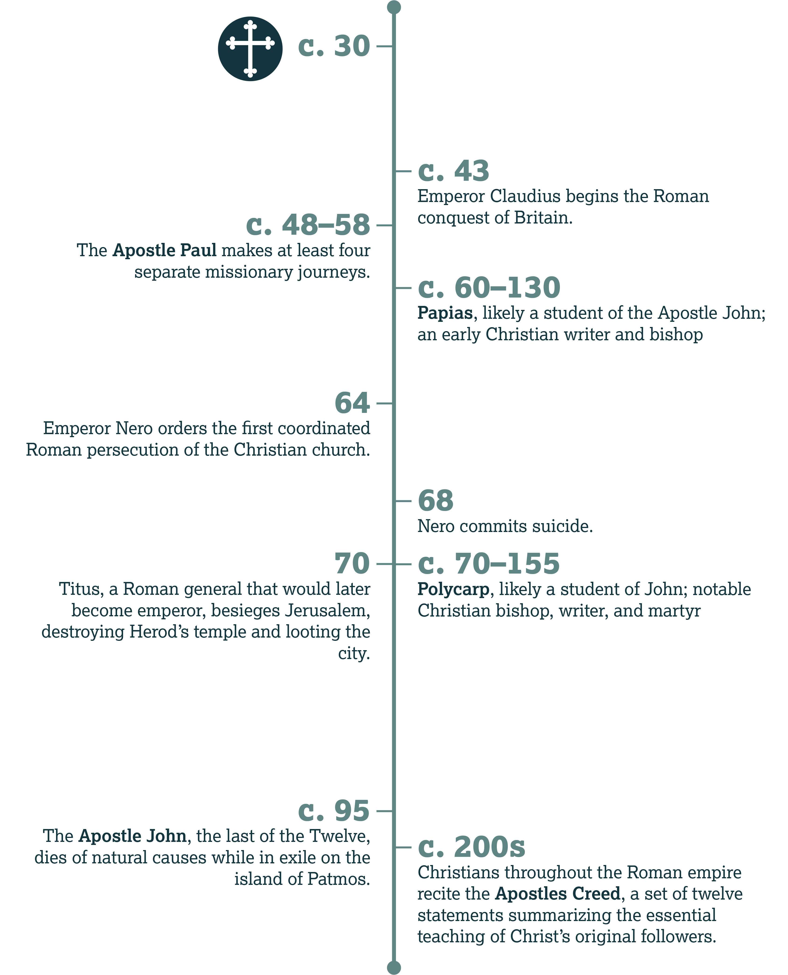

Slide 4
The Work of Papias
Introduction:

Slide 5
For I imagined that what was to be got from books was not so profitable to me as what came from the living and abiding voice.
—Papias, Exposition of the
Sayings of the Lord

Slide 6
The Hope of Christ

Slide 7
Divine Love (John 13)
Whose love should we imitate (v. 34)?
  Jesus’

Slide 8
Divine Love (John 13)
If we believers love each other this way, what will people understand (v. 35)?
  That we are disciples of Christ

Slide 9
Divine Unity (John 17)
Whose unity should we imitate (v. 21)?
  The Father and the Son

Slide 10
Divine Unity (John 17)
And if we pursue such godly unity, what will we help people see (vv. 21, 23)?
  That the Father sent Jesus to the world; that God loves us

Slide 11
Cultural Differences
Discussion:

Slide 12
What cultural differences do we have within our assembly?

Slide 13
What broader challenges make it difficult to be loving, unified Christians in our society?

Slide 14
The Central Practices of the Early Church

Slide 15
Pentecost
Context:

Slide 16
Acts 2
Verse 42: What did the believers do?
  The apostles’ teaching
  The fellowship of believers
  The breaking of bread
  Prayer

Slide 17
Acts 2
How did people outside the church react to this new movement (v. 43)?
  With awe/fear

Slide 18
How else did the believers show love to each other (vv. 44–47)?
  Sharing possessions (v. 44)
  Selling possessions for charity (v. 45)
  Worship and fellowship (vv. 46–47)
  God added daily to the church (v. 47)

Slide 19
The Apostles’ Teaching

Slide 20
The Canon
History:

Slide 21
The Apostles and Discipleship
Discussion:

Slide 22
Why do you think God didn’t just allow the church to continue under this sort of human, verbal inspiration?

Slide 23
Who has discipled you?

Slide 24
How can we pass on doctrine even without preaching in an assembly?

Slide 25
Fellowship

Slide 26
What do we share?
Acts 2:44–45; 1 John 3:17
  Material needs

Slide 27
What do we share?
Romans 12:15; Galatians 6:1–2
  Times of happiness and sorrow
  Rejoicing and weeping
  Emotional or spiritual burdens

Slide 28
What do we share?
Ephesians 5:18–21
  Worship
  Song
  Praise
  Gratitude
  Mutual service

Slide 29
What are some practical ways we can share our gifts with believers around us?

Slide 30
The Breaking of Bread

Slide 31
1 Corinthians 11
How did these believers fail to nurture communion (vv. 18–21)?
  They promoted divisions (vv. 18–19); some began eating before everyone arrived (v. 21); some went hungry while others even got drunk (v. 21).

Slide 32
1 Corinthians 11
Briefly list the steps your assembly takes to observe the Lord’s Supper.
Explain how one or more of these steps can promote a sense of unity.

Slide 33
Prayer

Slide 34
Why did they pray?
Acts 1:23–25
  To ask for guidance

Slide 35
Why did they pray?
Acts 14:21–23
  To encourage others and commit them to God

Slide 36
Why did they pray?
Colossians 1:9–12
  Out of a desire for believers to . . .
  Know God’s will with wisdom and understanding
  Please God
  Learn more about God
  Have strength, endurance, and patience
  And out of gratitude

Slide 37
Why did they pray?
Colossians 4:12–13
  To struggle/labor on behalf of other believers

Slide 38
Why did they pray?
James 5:14–16
  To request healing for the sick

Slide 39
Why did they pray?
1 Thessalonians 3:11–13
  To request that God make us increase and abound in love

Slide 40
Why did they pray?
1 Timothy 2:1–2
  To request that authorities allow us to live peacefully

Slide 41
What things should we ask God to give our assembly?

Slide 42
Consider John 17 and Matthew 26:36–46.
Why did Jesus need to pray?

Slide 43
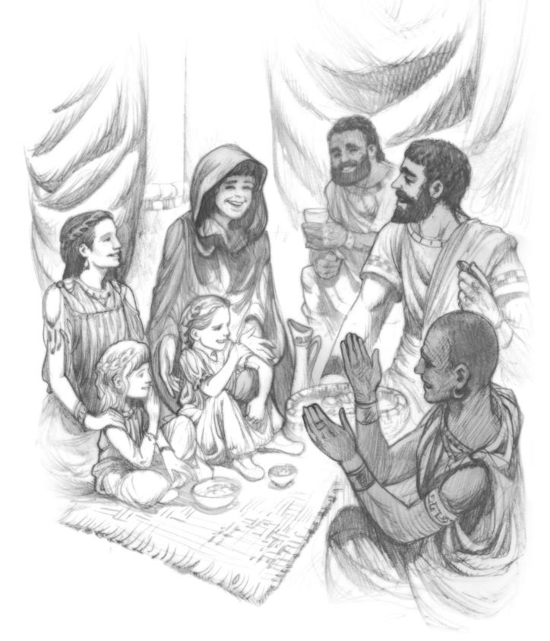
A Glimpse of the Early Church
Further Reading:

Slide 44
Tertullian’s Apology
What did you find similar between your assembly and the assembly described in this passage?

Slide 45
Tertullian’s Apology
What surprised you about Tertullian’s description?

Slide 46
Why do you think Tertullian describes prayer as a struggle?

Slide 47
What parts of this description reflect the principles of love and unity?

Slide 48
Why do you think Tertullian presented this as a defense of the church?

Slide 51
The Persecuted Church
CHAPTER 2

Slide 52
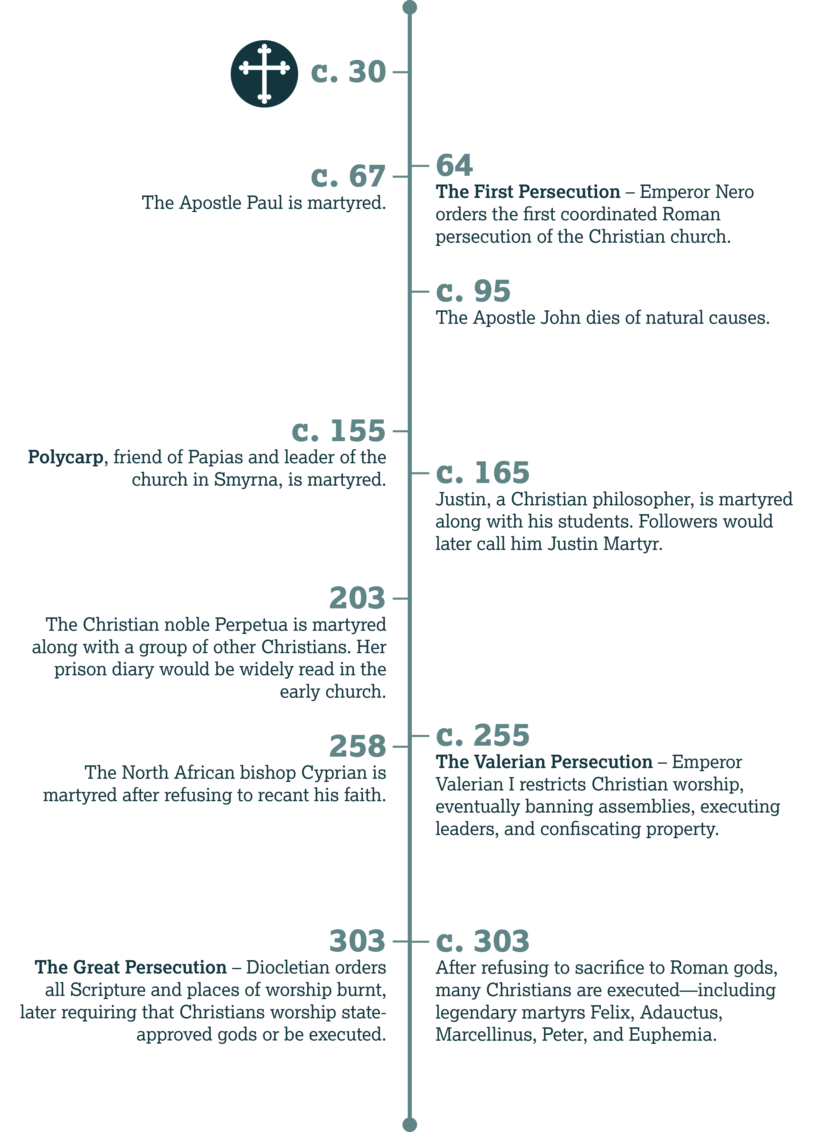

Slide 53
The Arrest of Polycarp
Introduction:

Slide 54
The Blessing of Christ

Slide 55
Matthew 5
What is the final beatitude repeated in verses 10 and 11?
  Blessed are those persecuted for righteousness’ sake.

Slide 56
What does Christ offer?
Verse 10:
  The kingdom of heaven is for them.
Verse 12:
  Their reward is great in heaven.

Slide 57
In what ways should Christians try to be different?

Slide 58
Persecution:
A Natural Conflict

Slide 59
John 15
How does Jesus describe our relationship with “the world” (v. 19)?
  We are not of the world. We don’t belong to it. Rather, Christ chose us out of the world.

Slide 60
John 15
Why shouldn’t we be surprised when “the world” hates us (vv. 20–21)?
  If they persecuted Christ, and we serve Him, they’ll persecute us, as well.

Slide 61
1 John 3:11–18
Context:

Slide 62
Early Persecutions of the Church

Slide 63
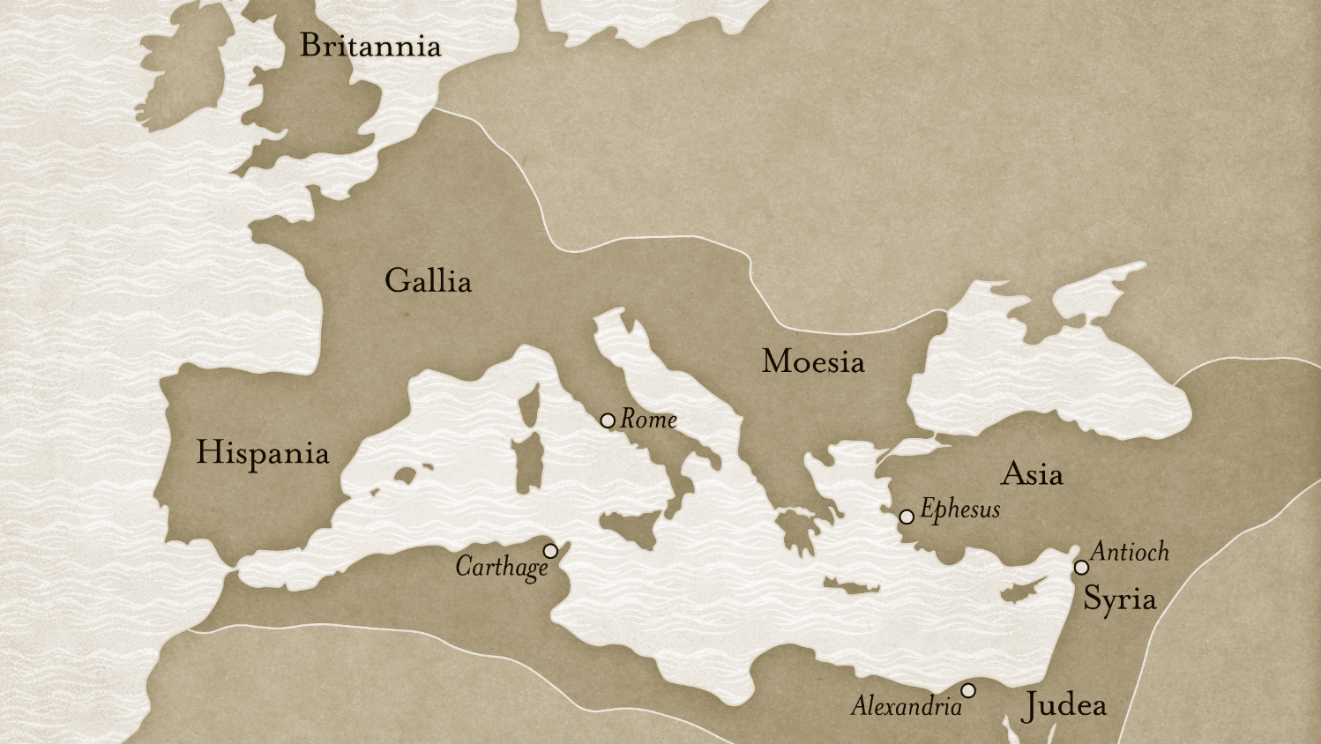

Slide 64
Tacitus,
The Annals
Discussion:

Slide 65
Felicitatis & the Early Martyrs
History:

Slide 66
John Foxe’s
Book of Martyrs
History:

Slide 67
Responses:
Avoiding Conflict by Denying Christ

Slide 68
Opportunities to Deny Christ
History:

Slide 69
Rome and
State Religion
History:

Slide 70
How do people avoid being identified as Christian today?

Slide 71
Matthew 10
What does Jesus promise those who openly identify with Him (v. 32)?
  Christ will acknowledge / confess them before God the Father.

Slide 72
Matthew 10
But what will happen to those who deny Christ (v. 33)?
  Christ will deny them before the Father.

Slide 73
Luke 22:54–62
Discussion:

Slide 74
Responses:
Viewing Suffering as Virtue

Slide 75
Examples of
Self-Martyrdom
History:

Slide 76
Matthew 10
How would you resolve the teaching of verses 23 and 39?
  Christians can and should avoid some persecution, but we must be willing to give our lives for the gospel.

Slide 77
In what context would it be wrong for a Christian to escape persecution?

Slide 78
Responses:
Accepting Persecution with Joy

Slide 79
A Great Reward
Context:

Slide 80
Hebrews 11:36–38
Discussion:

Slide 81
Responses to Suffering
Jesus, on the night before His crucifixion (Matt. 26:36–39)
  Jesus prayed in Gethsemane with His disciples (v. 36–37). He was extremely upset (v. 38), but He submitted to the Father (v. 39).

Slide 82
Responses to Suffering
The Apostles, after being whipped and reprimanded (Acts 5:40–41)
  They rejoiced at being counted worthy to suffer shame/disgrace for their association with Christ.

Slide 83
Responses to Suffering
Barnabas and Paul, after being thrown out of a city (Acts 13:50–51)
  They shook the dust off their feet and left, moving on to the next opportunity for ministry.

Slide 84
Can you think of other figures in the Bible who responded well to suffering?
What about negative examples?

Slide 85
The Prevailing Work

Slide 86
The Suffering of Others
Discussion:

Slide 87
A Testimony to the World

Slide 88
Imagery in Matthew 5
Verse 13:
  Salt
Verse 14:
  A light / a city on a hill
Verse 15:
  A light / lamp / candle

Slide 89
We multiply whenever we are mown down by you. The blood of Christians is seed.
—Tertullian, The Apology

Slide 90
What do we sacrifice for the sake of . . .
Personal relationships?
Ministry?

Slide 91
A Refinement of the Church

Slide 92
Anti-Christs
Context:

Slide 93
Note Luke 8:5–15. How does Christ communicate the same principle we find in 1 John 2?

Slide 94
A Portent of Judgment

Slide 95
Revelation 6
Who are these believers (v. 9)?
  People killed for the Word of God and for bearing witness for Him

Slide 96
Revelation 6
What do they ask God (v. 10)?
  How long before You judge and avenge our blood?

Slide 97
What answer do these saints receive (Rev. 6:11)?

Slide 98
Is it just for God to judge those who persecute His people?

Slide 99
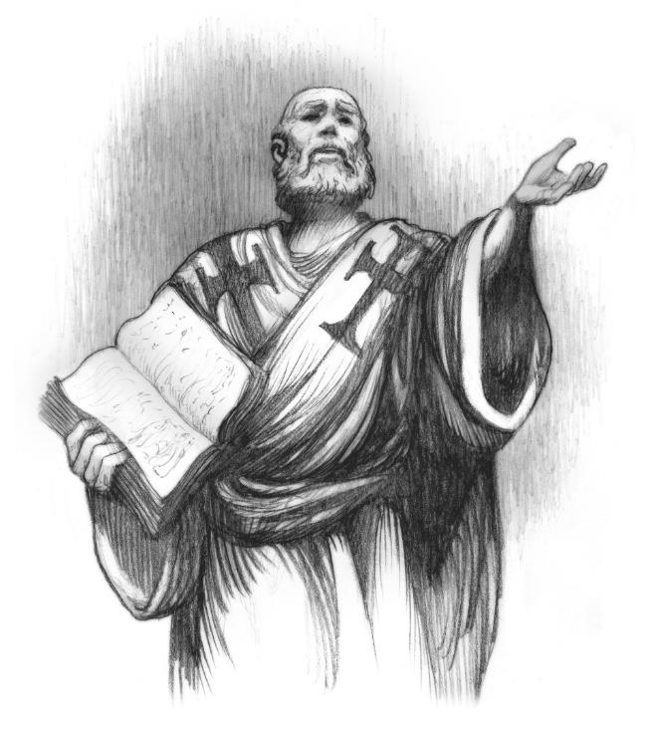
Polycarp’s
Stand
Further Reading:

Slide 100
What about “swearing by Caesar” do you think seemed wrong to Polycarp?

Slide 101
The Martyrdom of Polycarp
What reason did Polycarp offer for refusing to deny Christ?
  The faithfulness of God; the value of the eternal over the temporal

Slide 102
How do you think this scene affected believers who looked on? What about unbelievers?

Slide 103
Why do you think the Romans called Christians “atheists”?

Slide 106
Living in the World
CHAPTER 3

Slide 107
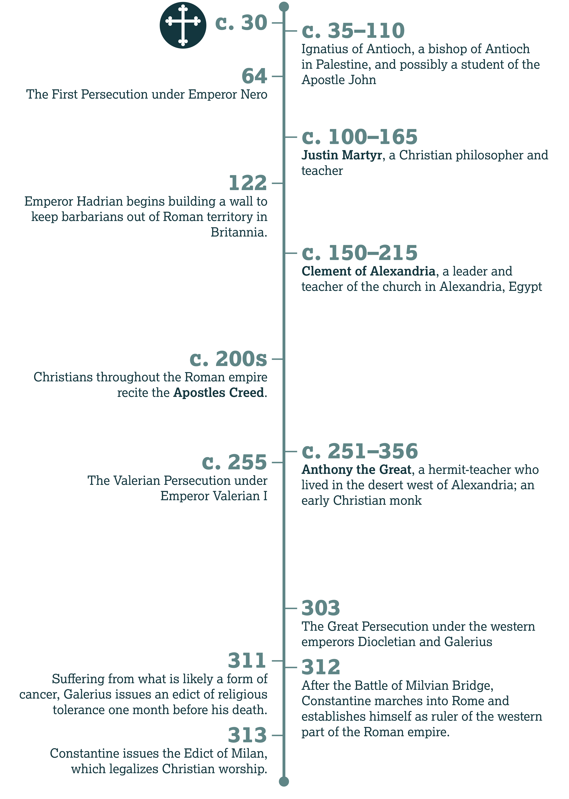

Slide 108
The Life of
St. Anthony
Introduction:

Slide 109
Do you think Anthony interpreted Christ’s teaching in Matthew 6:25 correctly?

Slide 110
Asceticism
Discussion

Slide 111
What are some visible elements of the world system?

Slide 112
Avoiding the World

Slide 113
John 17
What did Jesus ask the Father to do for us (v. 15)?
  Not to remove us from the world, but to protect us from evil / the evil one

Slide 114
Romans 7
What lives inside Paul, opposing him (vv. 20–21)?
  Sin/evil

Slide 115
Is it possible to escape evil by isolating ourselves?
Why or why not?

Slide 116
Jeremiah & Peter
Context:

Slide 117
The Physical vs. Spiritual
Discussion:

Slide 118
Engaging the World

Slide 119
Colossians 3
What phrase in verse 1 indicates that Paul is writing to fellow Christians?
  He addresses those who have been raised with Christ.

Slide 120
Colossians 3
In verse 2, what does Paul tell the Colossian believers to do?
  Set their minds/affections on things above, not on earthly things

Slide 121
Colossians 3
When Christ finally reveals Himself at the end of time, what will happen (v. 4)?
  We will also appear/be revealed in glory.

Slide 122
Focus and Attraction
Context:

Slide 123
Apologia
Context:

Slide 124
Be a Living Testimony

Slide 125
1 Peter 3
In verse 8, what does Peter challenge the believers to be?
  Terms will vary by translation. Christians should be unified, compassionate, loving, kind, and humble.

Slide 126
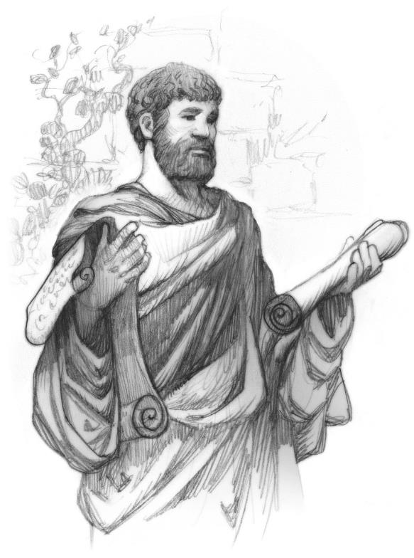
Justin
Martyr
History:

Slide 127
Respond with Blessing

Slide 128
1 Peter 3
Peter writes that we shouldn’t repay evil for evil—because believers are called to something higher. What are we called to both give and receive (v. 9)?
  A blessing

Slide 129
1 Peter 3
List every instruction from verses 10–11 that can help us avoid unnecessary trouble.
  We should avoid evil and deceptive speech (v. 10).
  We should turn from evil and do good (v. 11).
  We must pursue peace (v. 11).

Slide 130
1 Peter 3
In verse 12, what blessing does God promise the righteous?
  That He watches over them and hears their prayers

Slide 131
Blessing for Blessing
Context:

Slide 132
How can Christians be expected to respond to mistreatment and persecution with blessing?

Slide 133
Be Prepared to Answer

Slide 134
1 Peter 3
What question should we be ready to answer (v. 15)?
  What is the reason for the hope in us?

Slide 135
1 Peter 3
According to the end of verse 15, how should we speak to anyone questioning us about this?
  With meekness/gentleness and fear/respect

Slide 136
How did you state the principle of verse 17 in your own words?

Slide 137
What kind of questions do we not yet have a complete answer for?

Slide 138
What biblical figures maintained hope even when they didn’t have all the answers?

Slide 139
Beliefs of Second Century Christians
Further Reading:

Slide 140
All our life is a [holy] festival.
—Clement of Alexandria

Slide 141
. . . our Lord Jesus Christ . . . became what we are so that He could make us be what He is.
—Irenaeus of Lyons, Against Heresies

Slide 142
. . . how great will that be which follows His glorious appearing!
—Justin Martyr, Dialogue with Trypho

Slide 143
How did you respond to the challenge at the bottom of page 42?

Slide 144
The Apostles’ Creed
Discussion

Slide 145
What doctrines here have you heard recently in your church?

Slide 146
Are there any teachings you were surprised not to find in this creed?

Slide 147
Catholic vs. catholic
Teacher’s Note:

Slide 148
descendit ad inferos
Teacher’s Note:

Slide 151
From Persecution to Privilege
CHAPTER 4

Slide 152
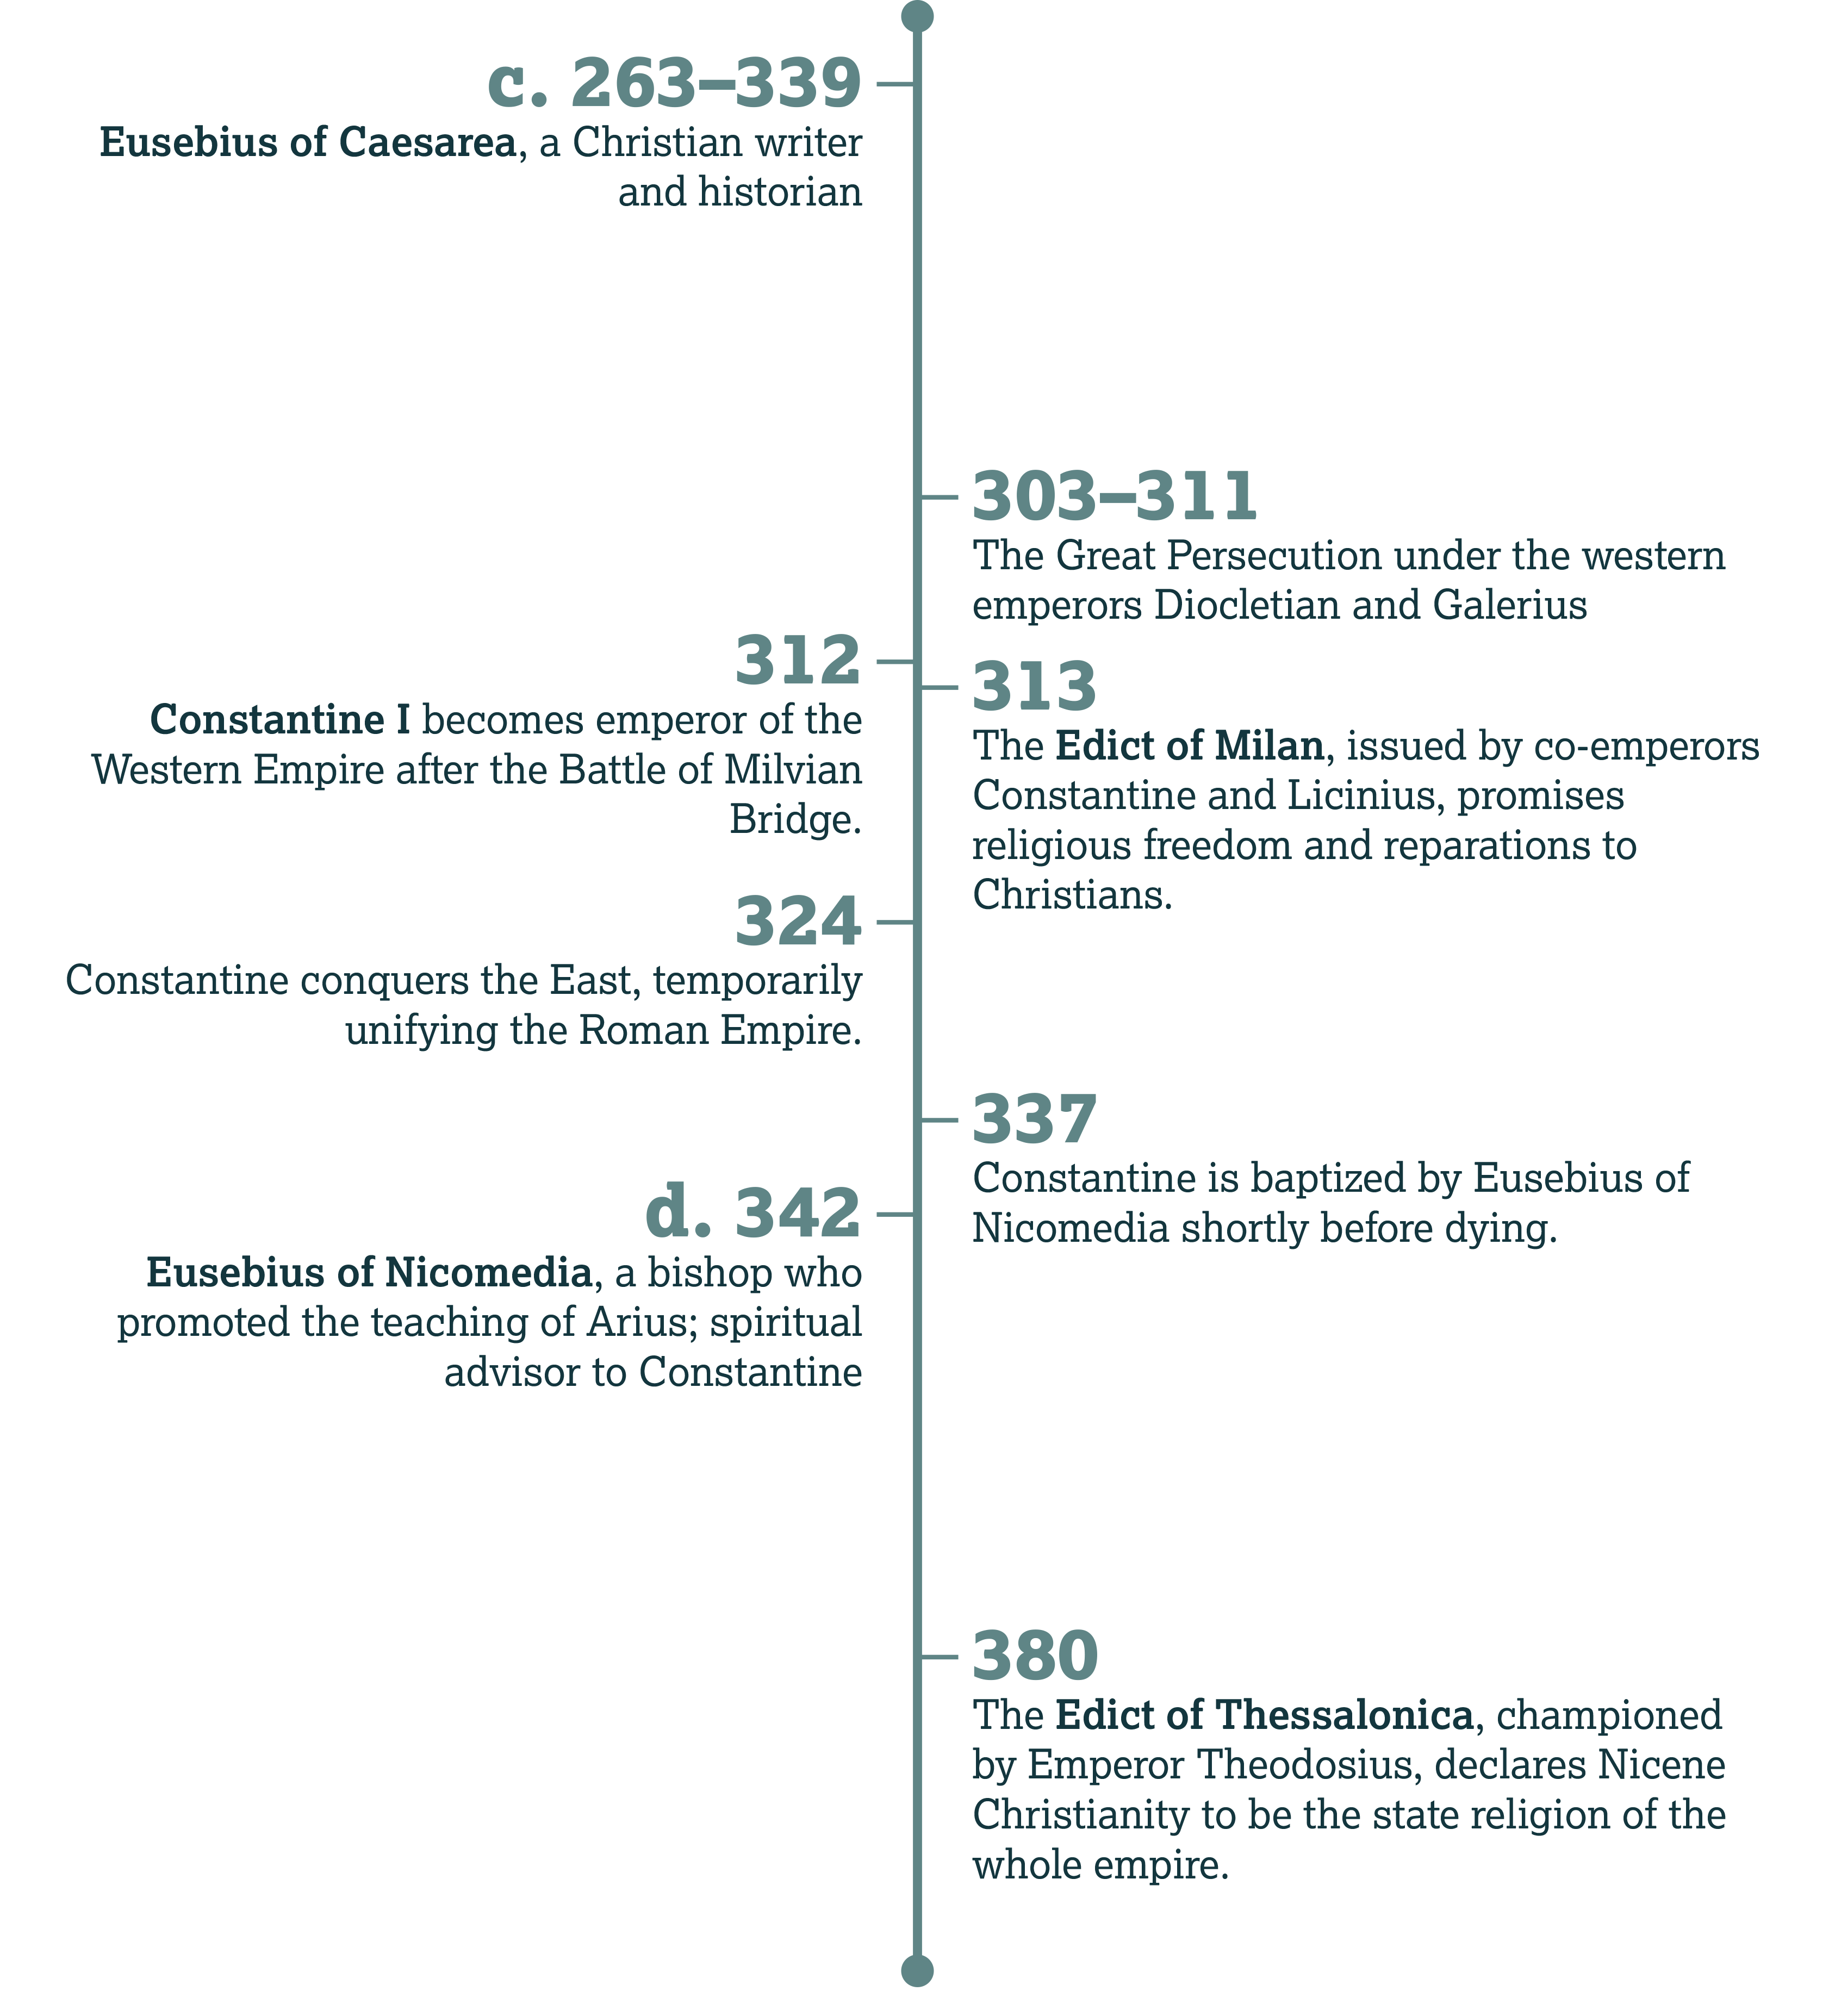

Slide 153
The Battle of Milvian Bridge
Introduction:

Slide 154
The Tetrarchy
History:

Slide 155
Minervina and Fausta
History:

Slide 156

The Chi-Rho
History:

Slide 157
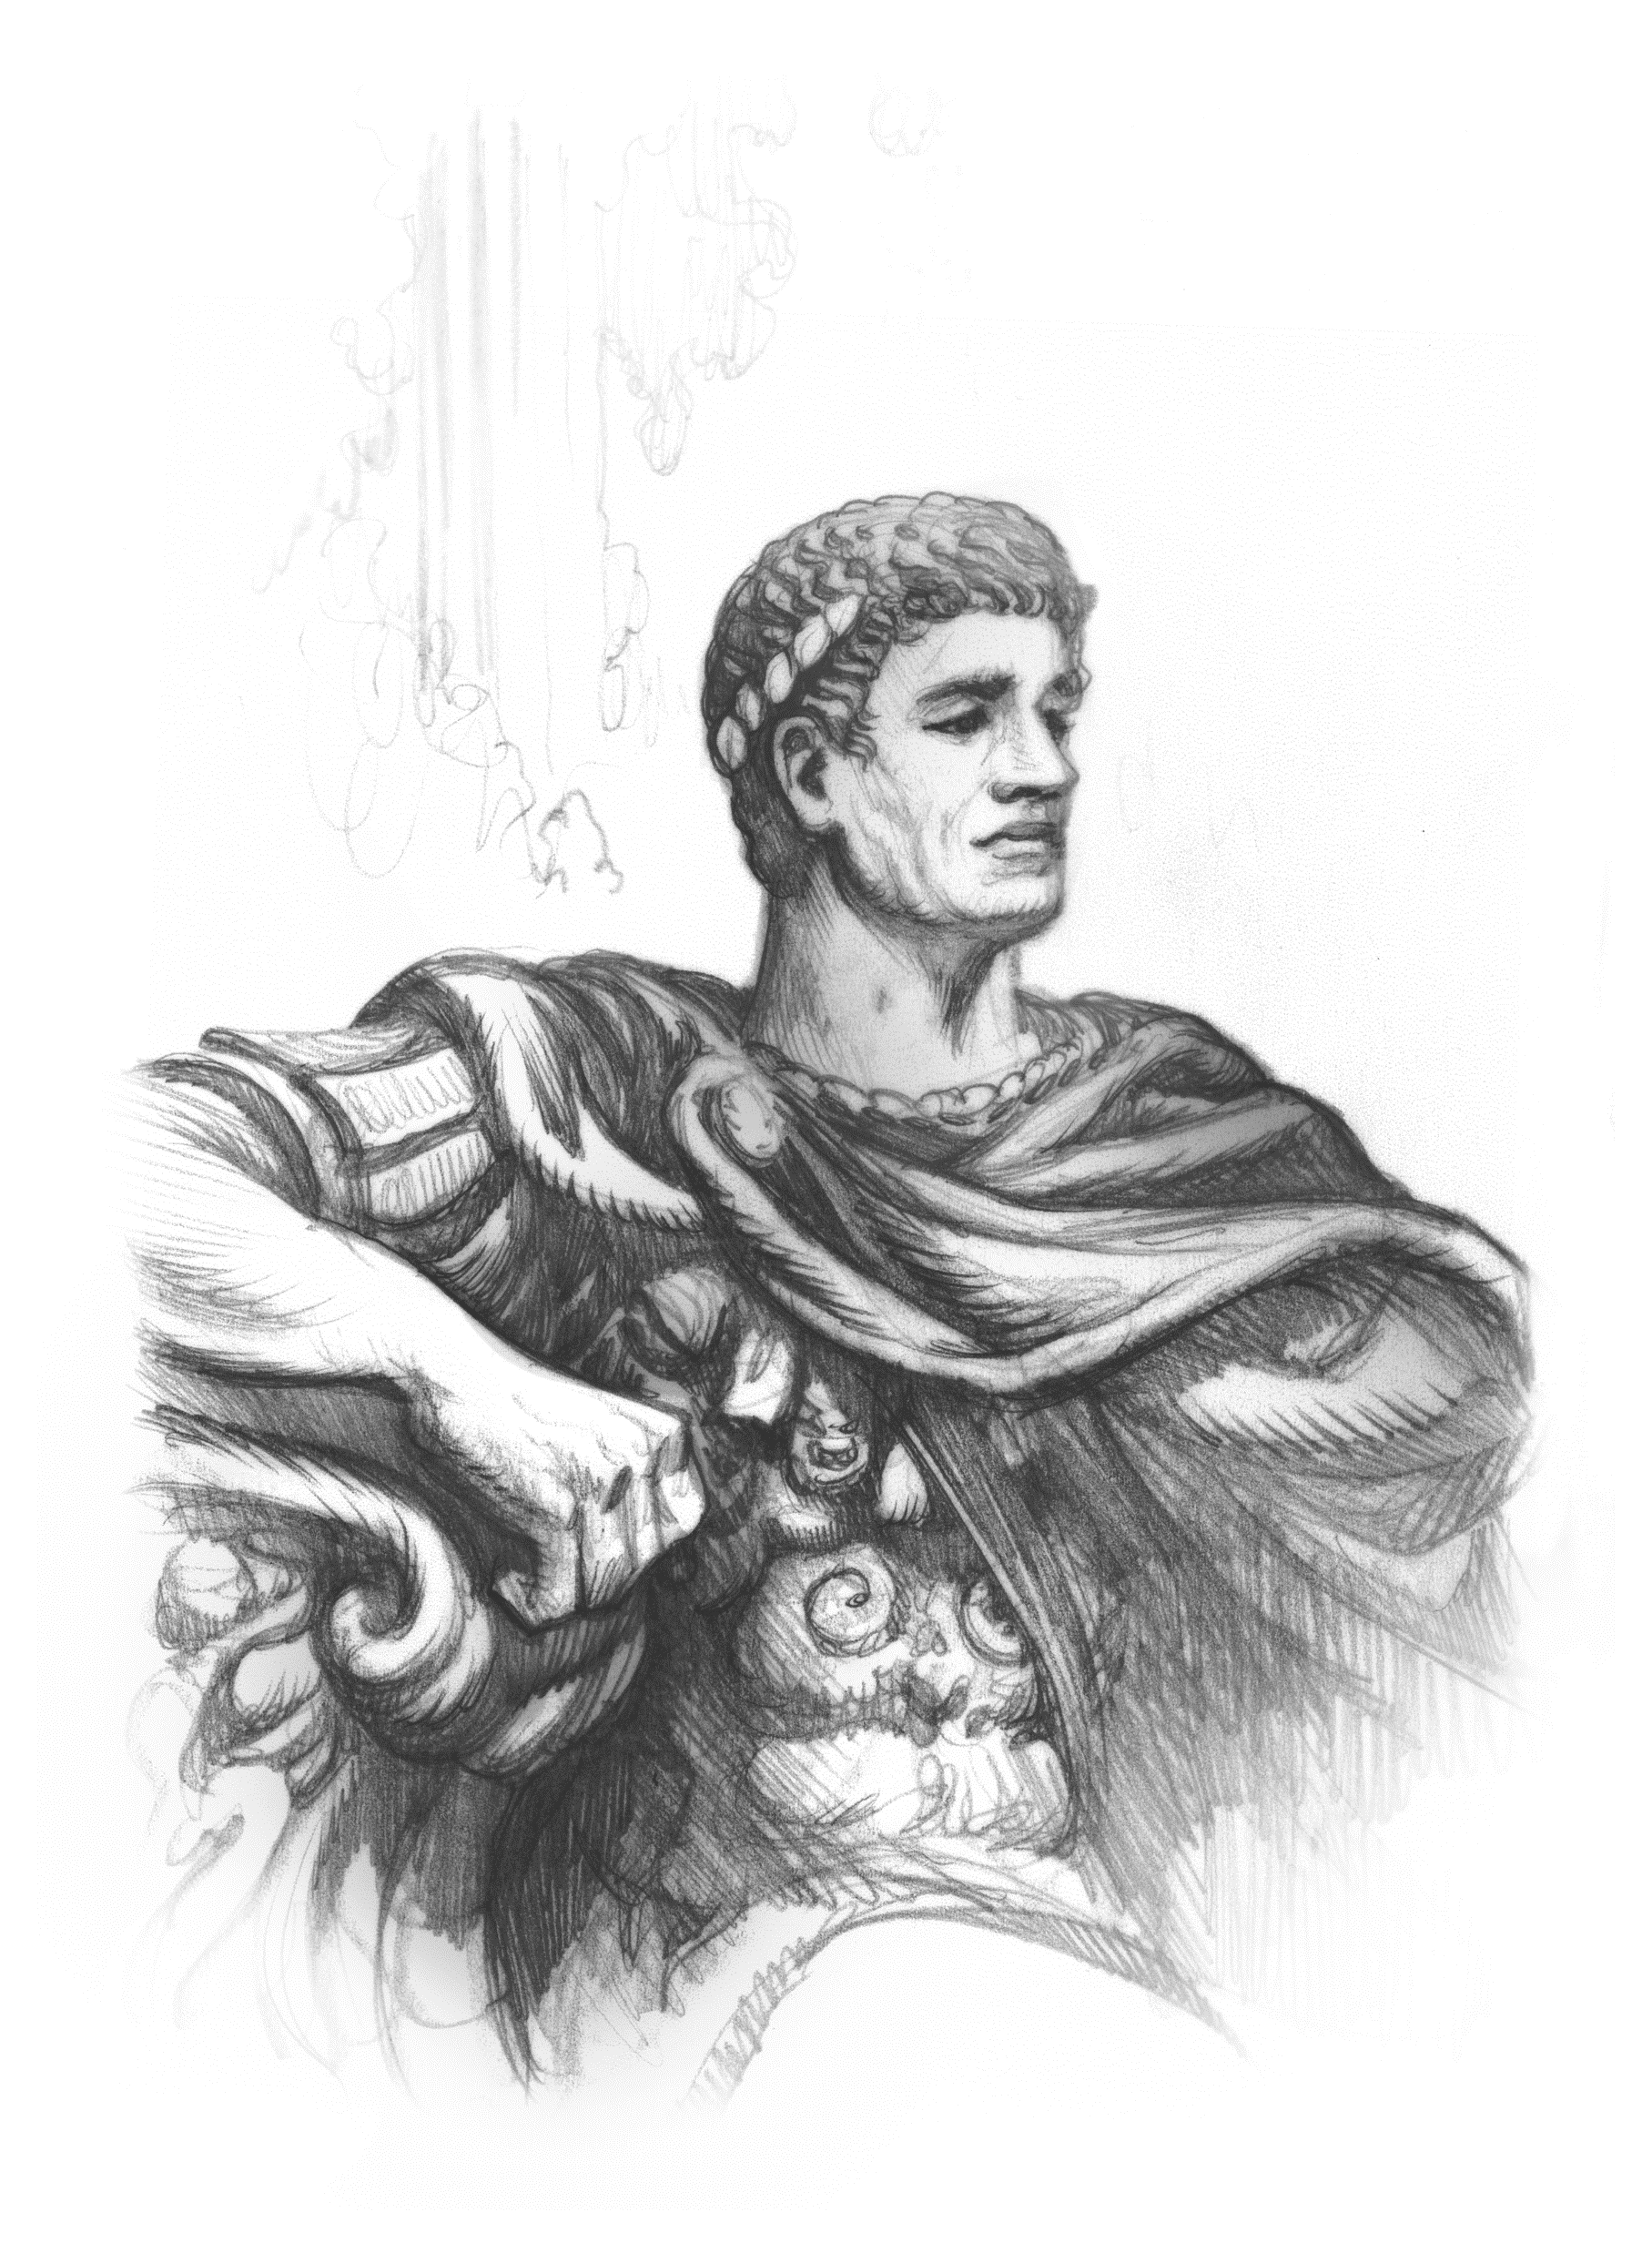
The Conversion of Constantine
History:

Slide 158
The Sovereignty of God

Slide 159
Daniel 2
According to verse 20, what two things belong to God?
  Wisdom and power/might

Slide 160
Daniel 2
How does He use these things to shape history?
  He changes times and seasons.
  He removes and establishes kings.
  He offers wisdom and knowledge.

Slide 161
Read Philippians 2:9–11 and
1 Corinthians 15:24–28.
In your own words, describe what every human authority will one day do.

Slide 162
Insecurity
Discussion:

Slide 163
The Benefits of Privilege

Slide 164
The Dangers of Privilege:
Appeasing the World

Slide 165
1 John 2
If we choose to love the world system, what kind of love do we not have (v. 15)?
  The love of the Father

Slide 166
1 John 2
What three things does John say the world offers (v. 16)?
  The desires (lusts) of the flesh
  The desires (lusts) of the eyes
  The pride of life

Slide 167
1 John 2
How does John contrast the fate of the world and the fate of people who obey God (v. 17)?
  The world and its desires pass away, but people who do God’s will live forever.

Slide 168
What biblical truths are currently popular?
Which are unpopular?

Slide 169
The Dangers of Privilege:
Pursuing Wealth and Power

Slide 170
Eusebius vs. Eusebius
Context:

Slide 171
Using Religion
The Pharisees in Matthew 6:16
  They did good works to be seen and praised by others.

Slide 172
Using Religion
Simon in Acts 8:14–21
  He tried to buy the power of the Holy Spirit for money, apparently to bolster his own prestige.

Slide 173
Using Religion
Divisive Teachers in Romans 16:17–18
  They cause divisions and put obstacles/offenses in the way of others, contrary to good teaching. They serve their stomachs, deceiving the naïve with smooth rhetoric and flattery.

Slide 174
Simony
History:

Slide 175
In what ways can you use your freedom for good?

Slide 176
What are some dangers or temptations that come with your freedom?

Slide 177
Freedom and Rights
Discussion:

Slide 178
The Edict of Thessalonica
Further Reading:

Slide 179
The Edict
What specific doctrine is mentioned as essential to Christianity?
  The deity and equality of all three members of the Trinity

Slide 180
The Edict
What does this edict call people who deny this doctrine?
  Insane, raving, heretical teachers; un-Christian

Slide 181
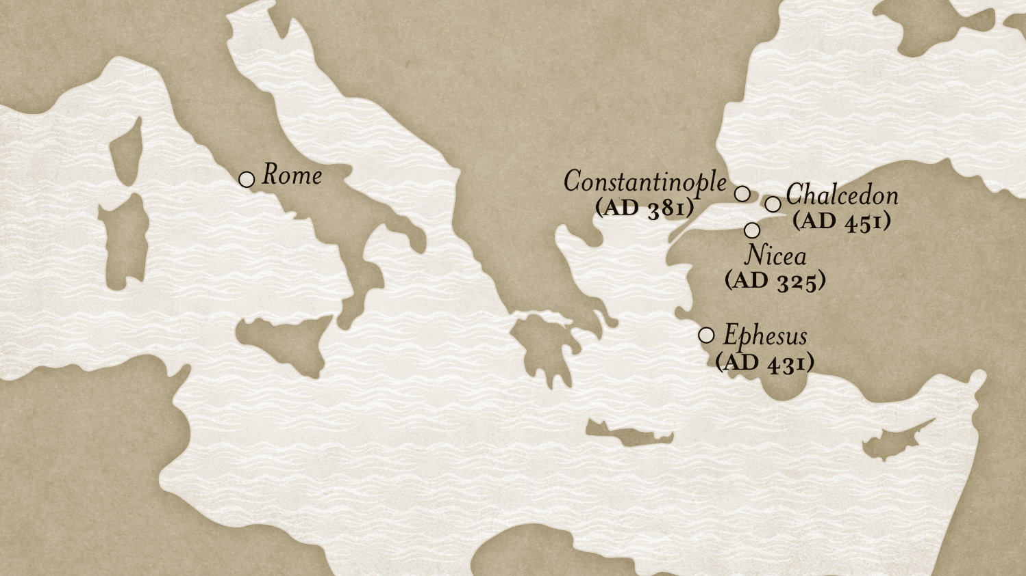

Slide 182
What do you think the writers meant by the last point in this edict?

Slide 183
How would the edict make your life easier?
How could it make your ministry more difficult?

Slide 186
Heresies
CHAPTER 5

Slide 187
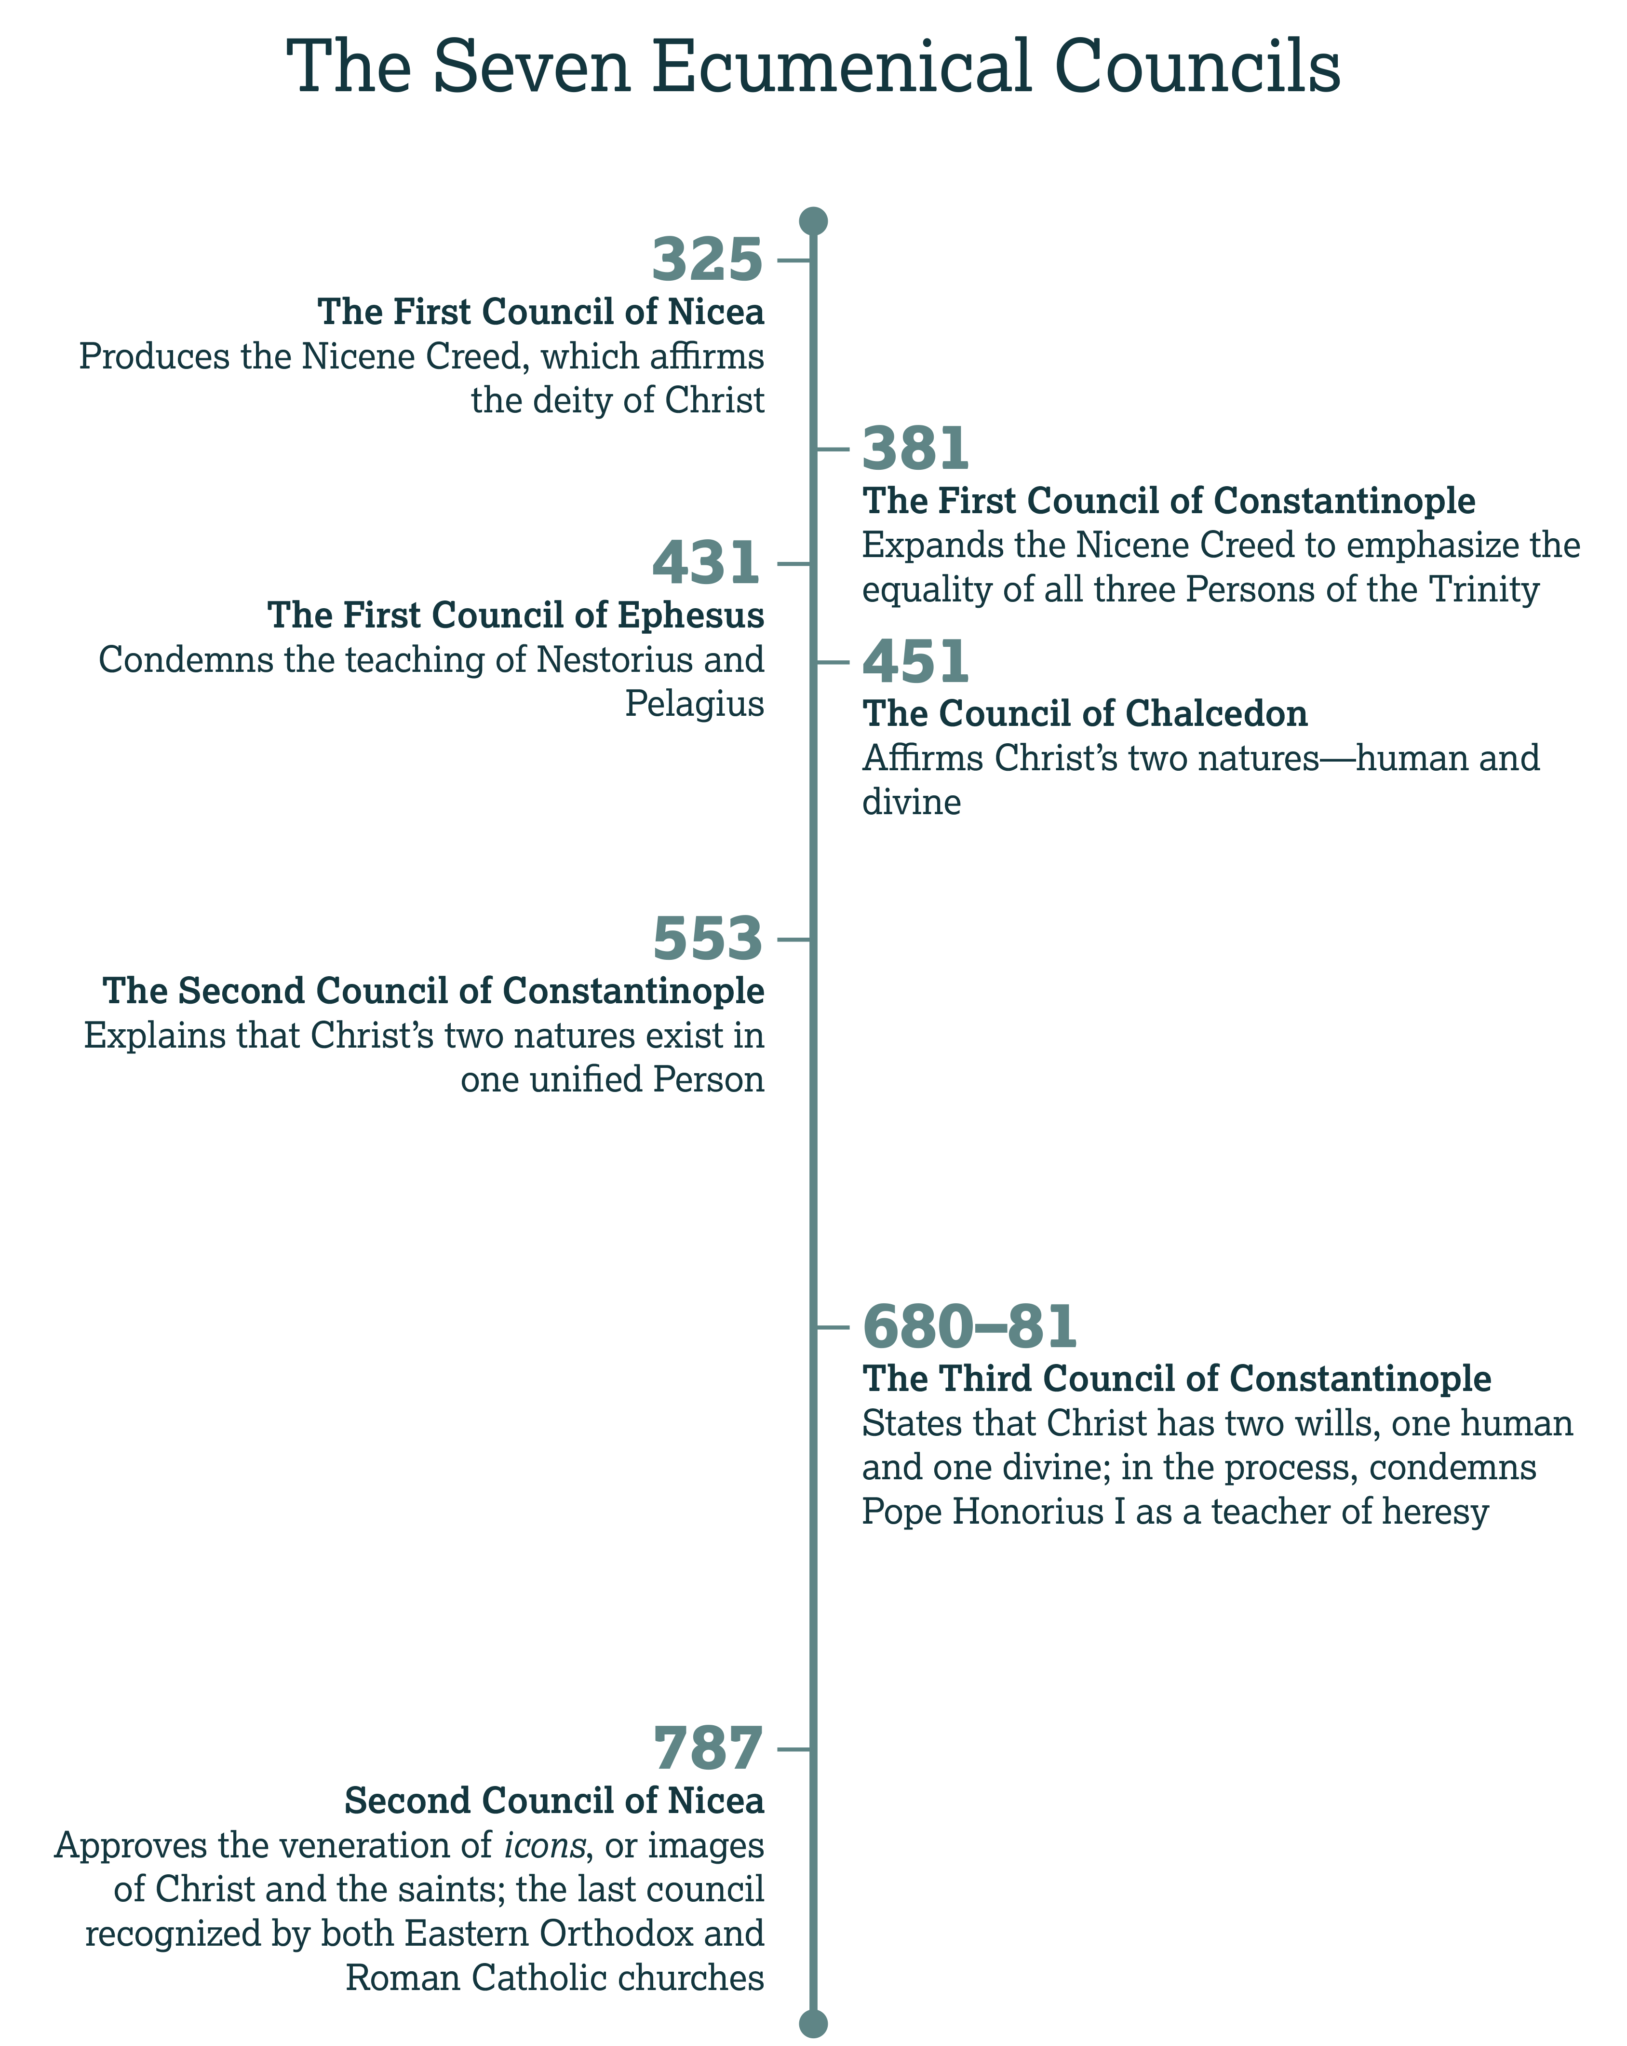

Slide 188
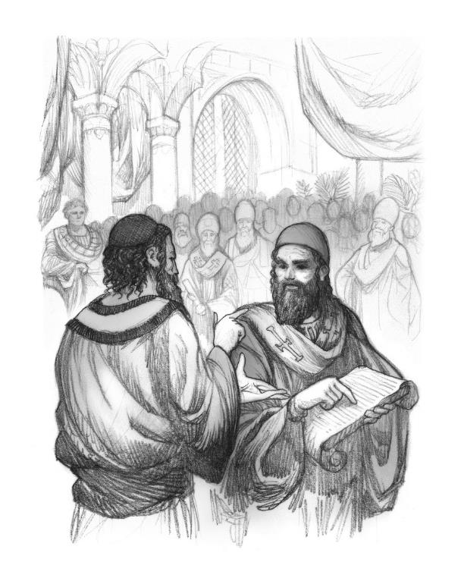
The Council of Nicea
Introduction:

Slide 189
Constantine and the Council
History:

Slide 190
Saint Nicholas
History:

Slide 191
Expansion of the Nicene Creed
History:

Slide 192
What ideas do you associate with the word heresy?

Slide 193
Scriptural Teaching on Heresy

Slide 194
2 Peter 2
Are these teachers open and honest about their doctrine (v. 1)?
  No, they bring in heresies secretly.

Slide 195
2 Peter 2
What is the ultimate heresy? Who do heretical teachers deny (v. 1)?
  The Lord/Master (Jesus Christ)

Slide 196
2 Peter 2
According to verse 2, what happens when people see so-called Christian teachers following evil?
  People malign the way of truth.

Slide 197
Is the universal church in danger just because people associate believers with false teachers?
If not, what’s so bad about false teaching?

Slide 198
2 Peter 2
Verse 4—The rebellious _______ that God imprisoned until the final judgment
angels

Slide 199
2 Peter 2
Verse 5—The _________________ destroyed by the Flood
old / ancient world

Slide 200
2 Peter 2
Verse 6—The cities of _______ and __________, which burned to ash
Sodom
Gomorrah

Slide 201
Ezekiel 16:49–50
Context:

Slide 202
Spotting a
False Teacher
Discussion:

Slide 203
Early Christian Heresies

Slide 204
Demi-Gods
History

Slide 206
Significant Early Heresies of the
Christian Church

Slide 207
Gnosticism
Primary Heresy | Scriptural Response
Physical = Evil Jesus couldn’t have been a physical man. | New Testament Canon The humanity of Christ

Slide 208
Montanism
Primary Heresy | Scriptural Response
Montanus claimed direct revelation. | Unique authority of God through Scripture

Slide 209
Monarchianism
Primary Heresy | Scriptural Response
God appears through different modes. | The Trinity of Three Persons

Slide 210
Arianism
Primary Heresy | Scriptural Response
Jesus is the first created being, and therefore not fully God. | The equality of the Father and Son

Slide 211
Monophysitism
Primary Heresy | Scriptural Response
Jesus was a divine spirit occupying a human body. | The hypostatic union, or dual nature

Slide 212
Pneumatomachianism
Primary Heresy | Scriptural Response
The Holy Spirit was created by God, and therefore not fully divine. | The Spirit’s eternal equality with the Father and Son

Slide 213
Pelagianism
Primary Heresy | Scriptural Response
Pelagius denied original sin and implied that we have the chance to work our way to righteousness. | Salvation by grace alone

Slide 214
Early Heresies
What doctrine did most of these heresies target?
  The nature of Jesus Christ

Slide 215
Were there any doctrines or controversies in this table that you didn’t understand?

Slide 216
Arianism
History:

Slide 217
Why do you think the doctrine of Christ was such a focus of debate?

Slide 218
The Expanded Nicene Creed
Further Reading:

Slide 219
“catholic” and “baptism”
Context:

Slide 220
The Constantinopolitan Creed
Which member of the Trinity receives the longest treatment?
  The Son

Slide 221
The Constantinopolitan Creed
What heresy does this creed correct by emphasizing the physical incarnation, crucifixion, and burial of Christ?
  Likely docetic gnosticism

Slide 222
The Constantinopolitan Creed
What functions or roles does the creed associate with the Holy Spirit?
  Lordship/authority
  The giving of life
  The acceptance of worship
  Prophetic guidance

Slide 223
Why does the creed say that the Holy Spirit “proceeds” in the present tense?

Slide 224
Did you find any of these additions interesting or confusing?

Slide 227
No Earthly City
CHAPTER 6

Slide 228
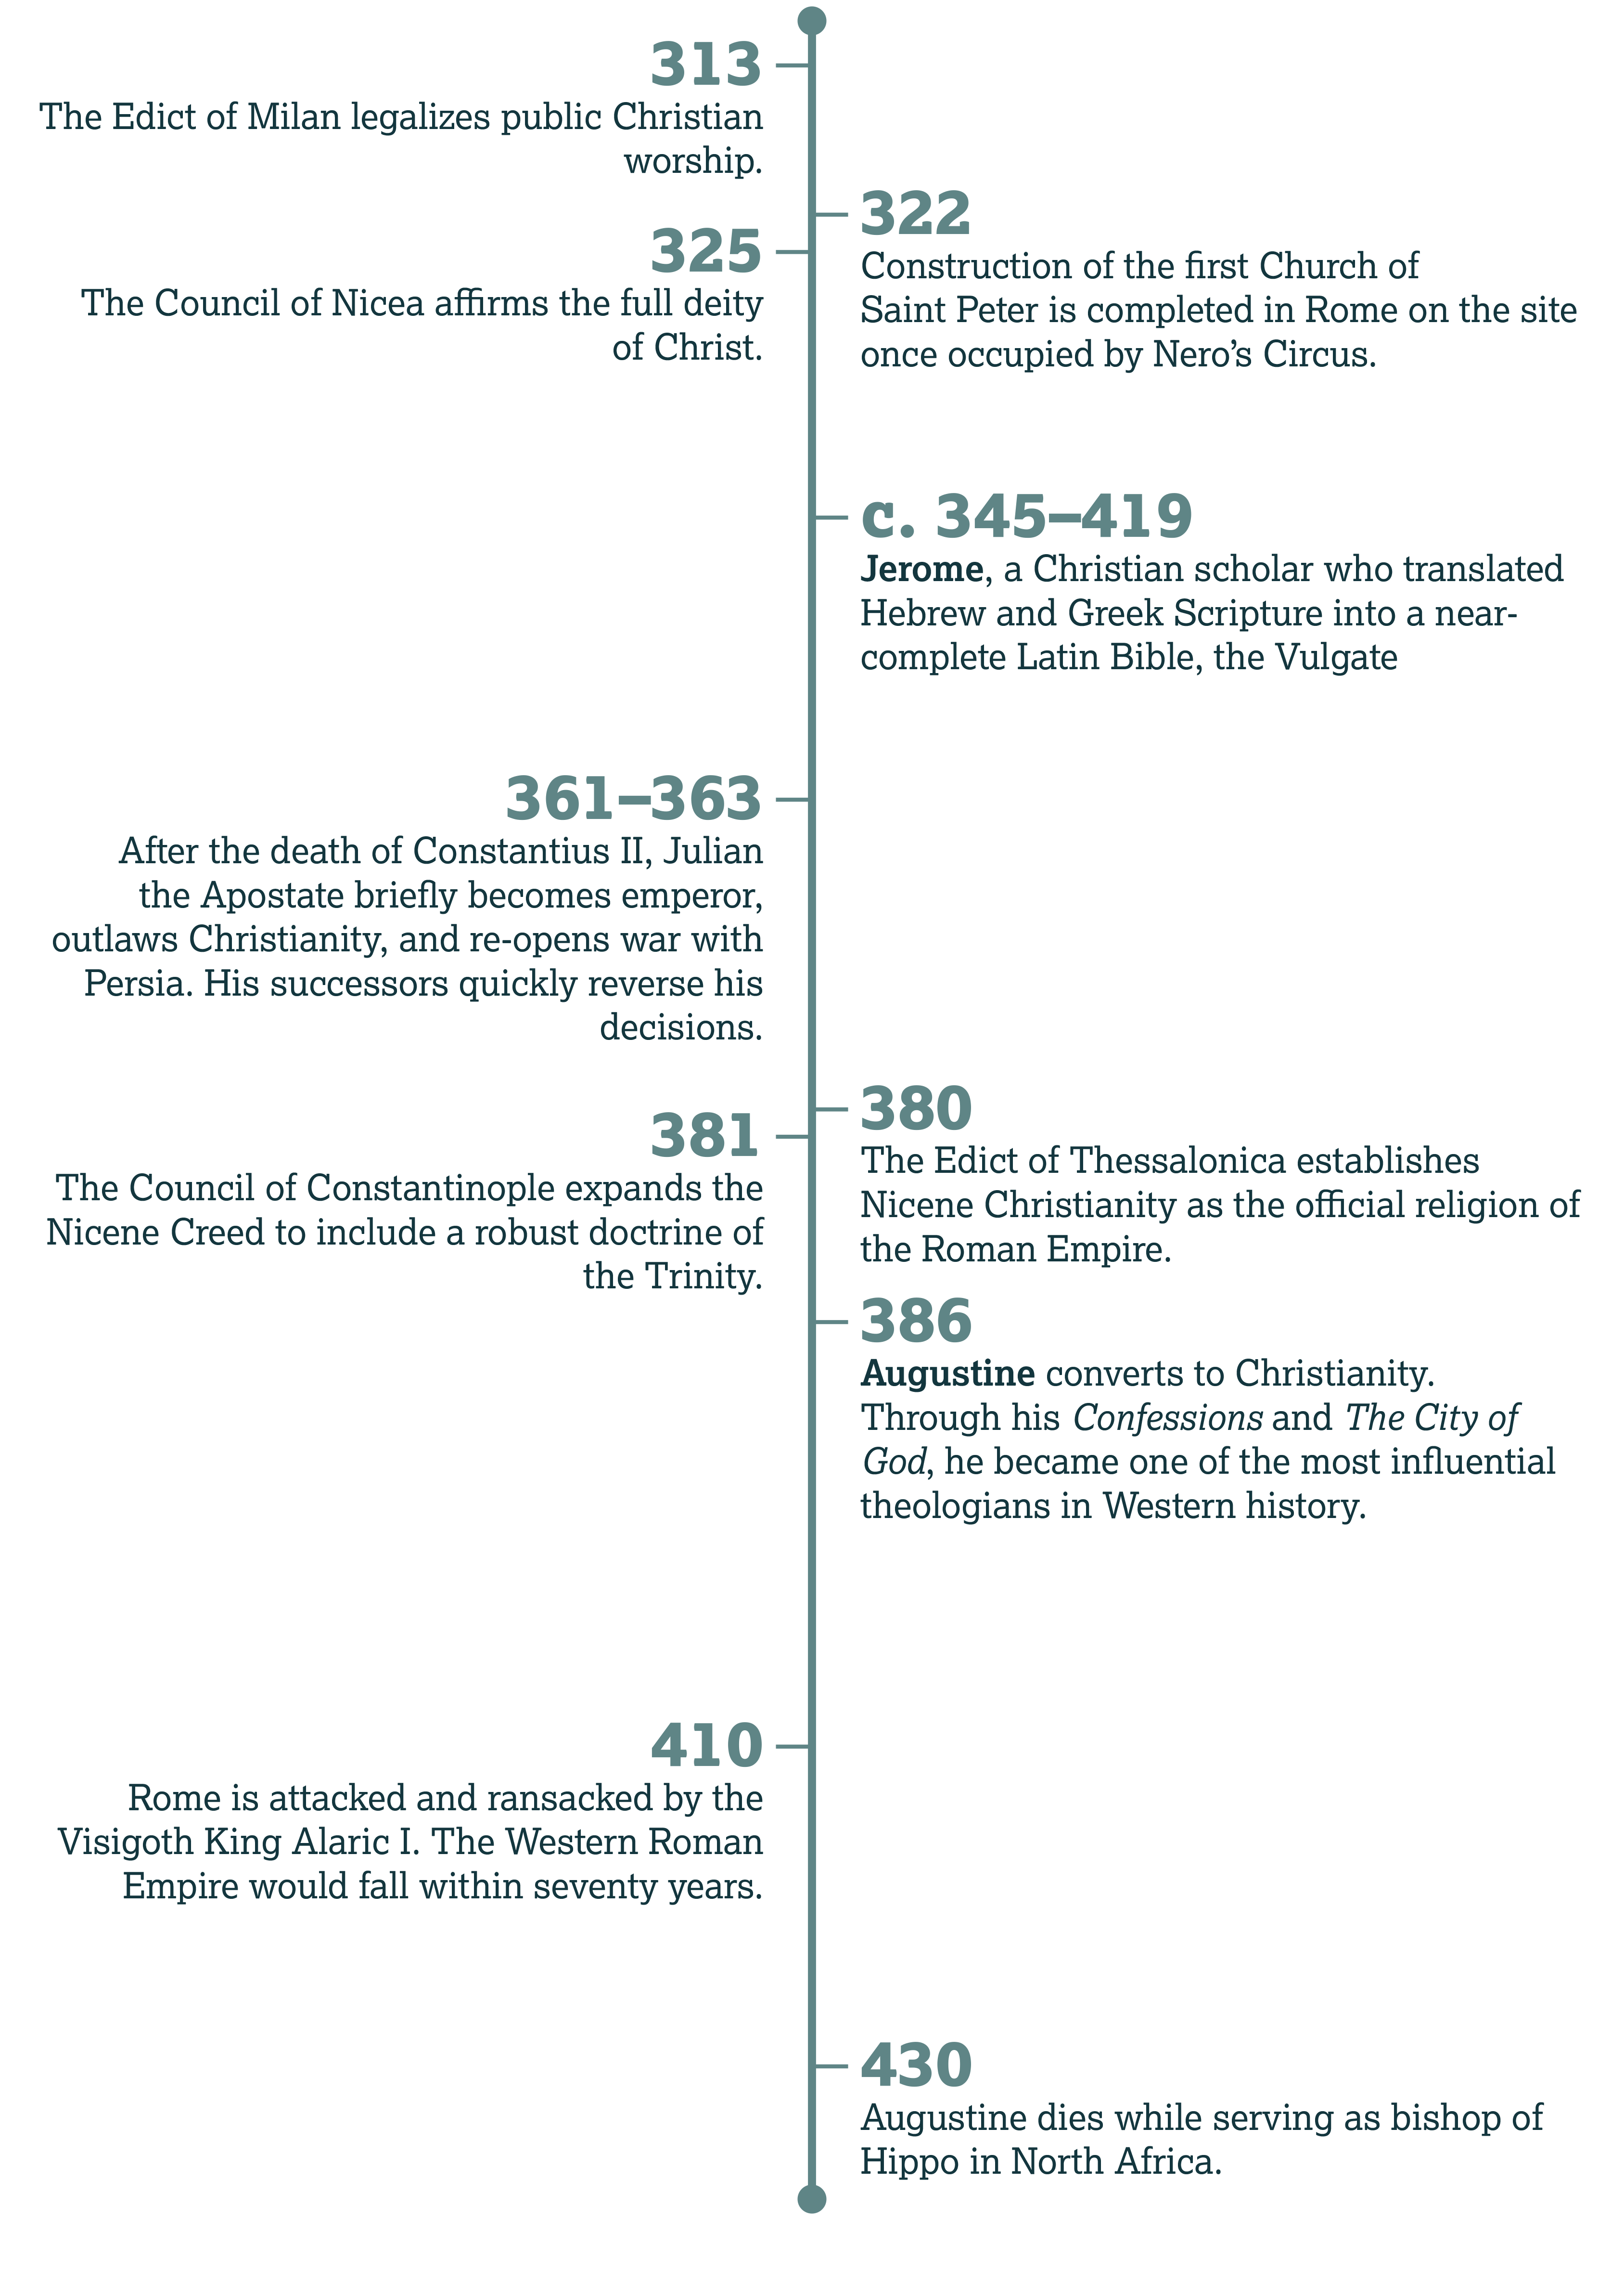

Slide 229
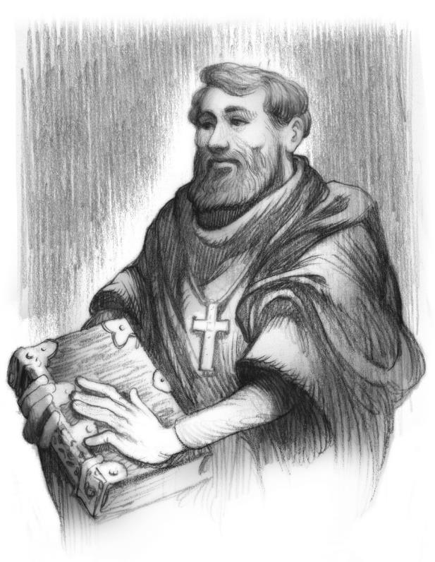
The City of God
Introduction:

Slide 230
Constantinople
History:

Slide 231
For He has promised it, and cannot lie, and has already performed many of His promises, as well as many unpromised kindnesses to those whom He now asks to believe that He will do this, also.
—Augustine,
The City of God, 22.1

Slide 232
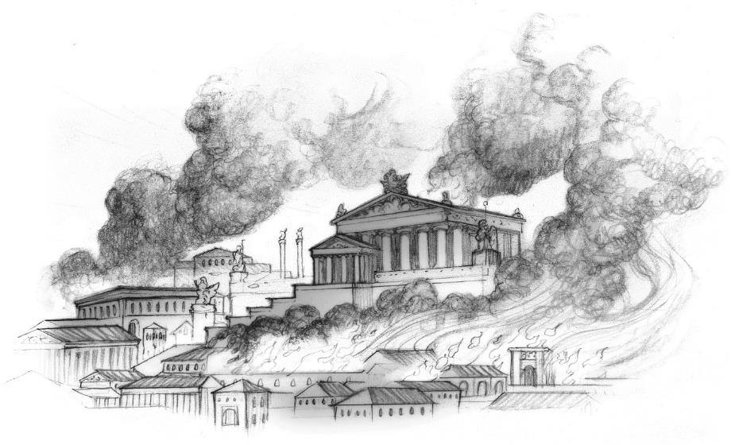
Leaving the Earthly City

Slide 233
Galatians 4
In this allegory, what does Hagar represent (vv. 24–25)?
  Slavery; bondage; Sinai; present Jerusalem

Slide 234
Galatians 4
But how does Paul describe the heavenly Jerusalem (v. 26)?
  Free; and our mother

Slide 235
Old vs. New
Context:

Slide 236
Finding the
City of God

Slide 237
What challenges do children face growing up in a family where only one parent is a believer?

Slide 238
How might Romans 13:11–14 have convicted Augustine?

Slide 239
Hebrews 11
How did Abraham first display this faith (v. 8)?
  He obeyed when God called him to leave his home [the city of Ur] and go to a place he didn’t yet know.

Slide 240
Hebrews 11
When he arrived, how did he live (v. 9, 13)?
  He lived in tents, like a stranger, a foreigner, pilgrim, or exile.

Slide 241
Hebrews 11
Why did he live this way (v. 10)?
  He looked forward to a city designed and built by God.

Slide 242
Hebrews 11
Likewise, what promise did Sarah accept in faith (vv. 11–12)?
  That she would conceive and bear a child, the first of many descendants

Slide 243
Hebrews 11
Did Abraham and Sarah get to see all of God’s promises fulfilled during their lifetime (v. 13)?
  No.

Slide 244
Hebrews 11
Hebrews 11 describes people of faith. Instead of the places they leave behind, what do faithful believers desire (v. 16)?
  A better, heavenly country; a city prepared by God

Slide 245
Hebrews 11
What does God prepare for these people (v. 16)?
  God prepares them an eternal city—heaven.

Slide 246
Are there other promises about eternity that you find encouraging?

Slide 247
Faith in God’s City
Discussion:

Slide 248
The Work of Augustine:
Becoming a Minister

Slide 249
The Conversion Process
History:

Slide 250
Jerome’s Vulgate
History:

Slide 251
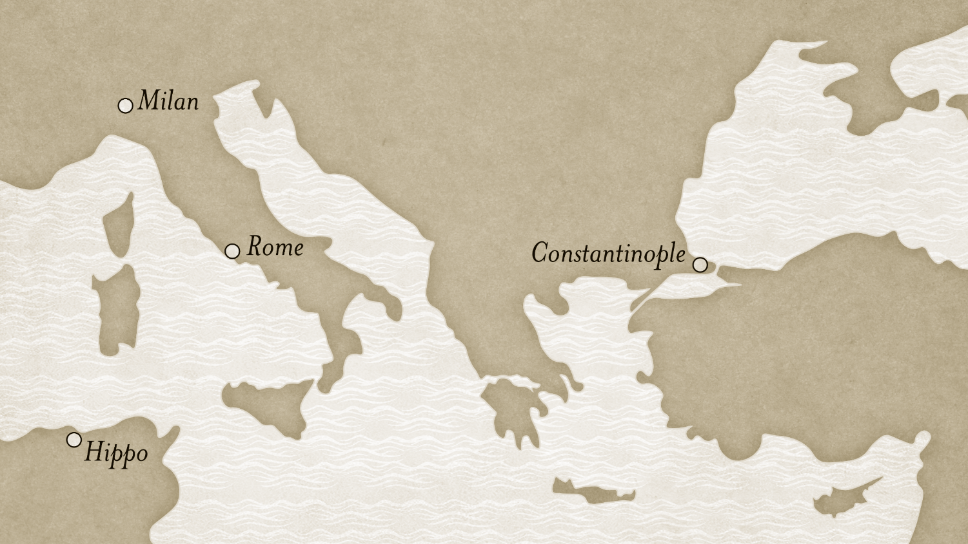

Slide 252
The Work of Augustine:
Addressing Controversies

Slide 253
Forgiving Apostasy
Discussion:

Slide 254
The Work of Augustine:
Concluding His Ministry

Slide 255
The Legacy of Augustine
History:

Slide 256
Manichaeism, Donatism, and Pelagianism
Discussion:

Slide 257
Ephesians 2:19–22
Discussion:

Slide 258
Augustine’s Confessions
Further Reading:

Slide 259
Augustine’s Confessions
According to the first two paragraphs, what is humanity’s true desire?
  To praise God

Slide 260
Augustine’s Confessions
What phrase does Augustine use twice in the first paragraph to describe humanity?
  “A particle of Your creation”

Slide 261
“. . . you have formed us for Yourself, and our hearts are restless until they find rest in You.”

Slide 264
To the Regions Beyond
CHAPTER 7

Slide 265
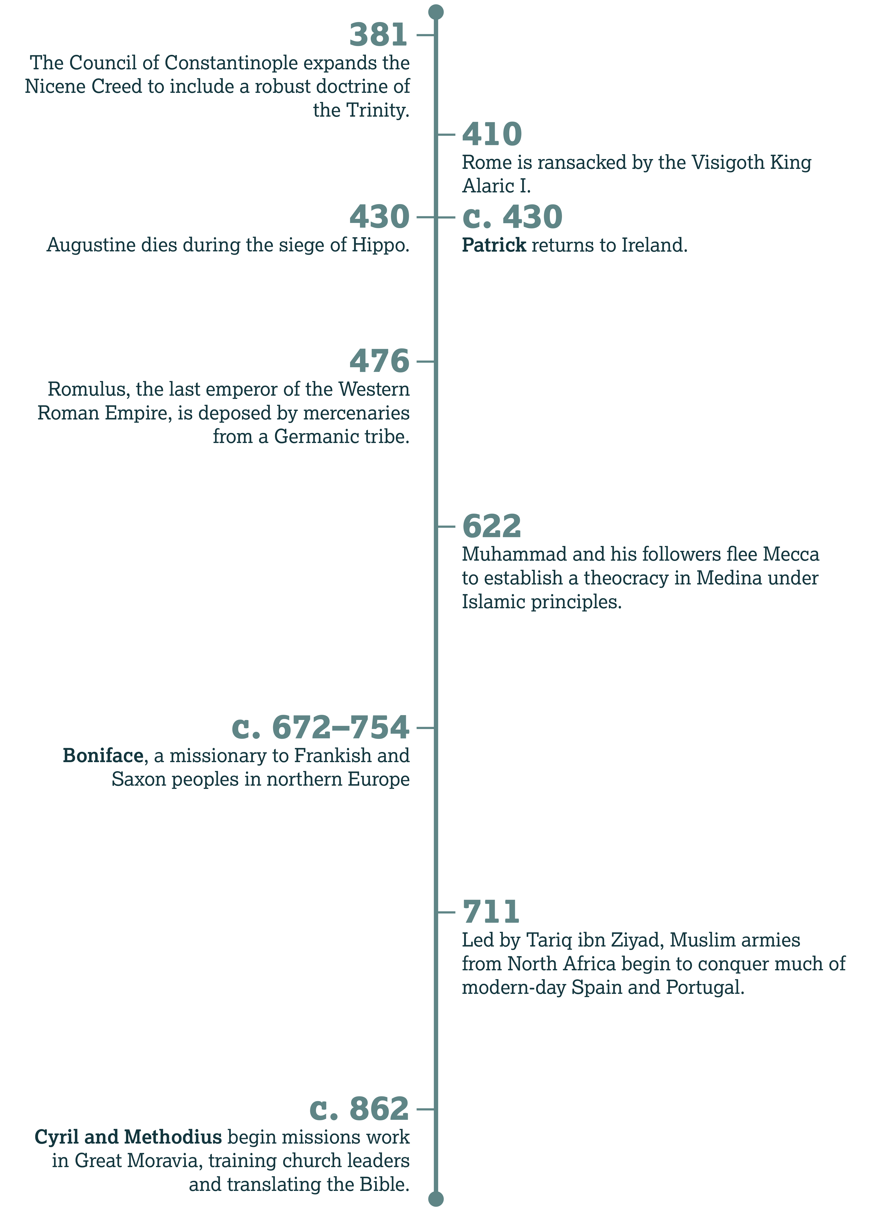

Slide 266
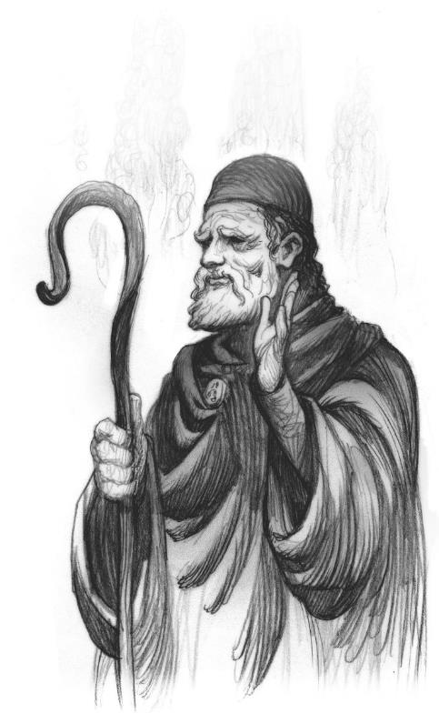
Patrick
Introduction:

Slide 267
March 17
History:

Slide 268
To the Ends of the Earth

Slide 269
Matthew 28
Over what realms does Jesus claim power and authority
(v. 18)?
  In heaven and on Earth

Slide 270
Matthew 28
Given that sovereignty, where does Jesus command His followers to go?
  To all nations

Slide 271
Matthew 28
What two things does Jesus command His followers to do as they go?
  They should teach/make disciples, and they should baptize believers.

Slide 272
Matthew 28
Note the first phrase in verse 20. How exactly do we disciple?
  We disciple by teaching others Christ’s commands/doctrine.

Slide 273
Why do you think Jesus declares His authority before giving the Great Commission?

Slide 274
What opportunities do we have to disciple people?
What ways did you list?

Slide 275
The Teaching of Christ
Matthew 6:33
  Seek God’s kingdom above all else

Slide 276
The Teaching of Christ
Matthew 22:36–38
  Love God completely—with all heart, soul, mind

Slide 277
The Teaching of Christ
Matthew 22:39
  Love your neighbor like you do yourself

Slide 278
The Teaching of Christ
Luke 9:23–24
  Deny yourself and follow Christ

Slide 279
The Teaching of Christ
John 13:34–35
  Love one each other as fellow disciples, just as Christ loves you

Slide 280
What happens when we try to share a “gospel” without Christ and His teaching?

Slide 281
Disciples Making Disciples

Slide 282
2 Timothy 2
Discussion:

Slide 283
Would you like to share who led you to Christ?
Who are the people that have invested in you and discipled you?

Slide 284
What ways did you think of to prepare people to prepare others?

Slide 285
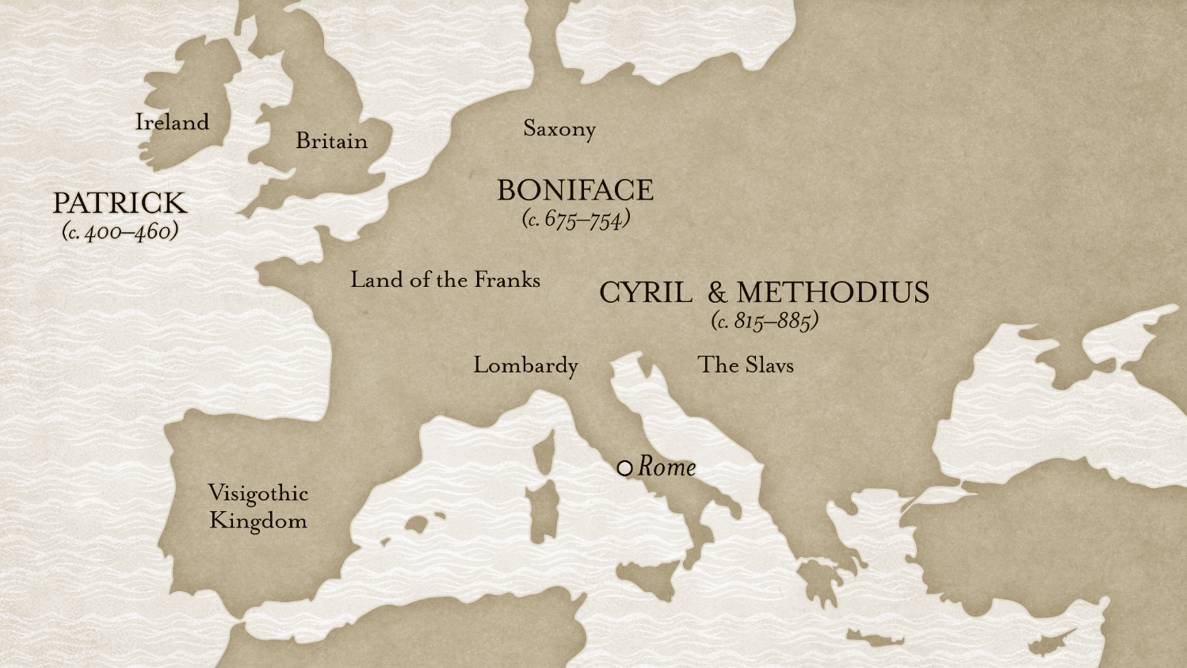

Slide 286
Early Medieval Missions Work:
Boniface

Slide 287
Early Medieval Missions Work:
Cyril and Methodius

Slide 288
Writing in Crisis
Further Reading:

Slide 289
Uncertain Outcome
History:

Slide 290
Which parts of this letter hint that Patrick struggles with his own national identity?

Slide 291
Can you think of modern missionaries who face difficulties because of the actions of their home country?

Slide 292
Do you think Patrick’s tone was appropriate?

Slide 293
Did anything about this letter surprise you?

