Slide 2
Light for the
Dark Ages
CHAPTER 8

Slide 3
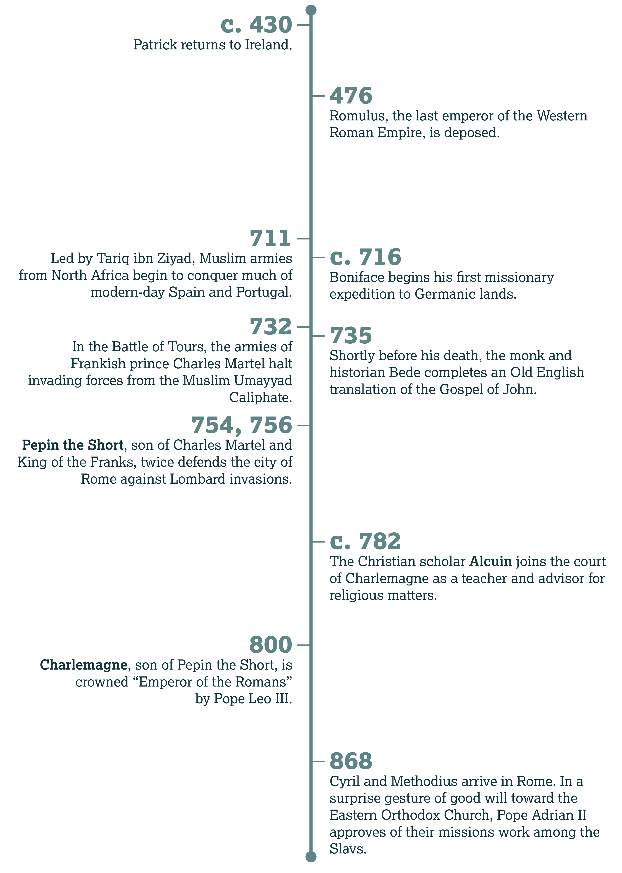

Slide 4
Alcuin
Introduction:

Slide 5
Bede the Venerable
History:

Slide 6
What responsibilities do we have toward civil authorities?

Slide 7
The God Watching Over History

Slide 8
What parts of our current civilization can be used for the good of God’s kingdom?

Slide 9
Psalm 103
Why does God not immediately judge us (vv. 10–14)?
  He shows compassion, especially to those that fear Him. He understands our weakness.

Slide 10
Psalm 103
How does the psalmist picture the length of our lives (vv. 15–16)?
  Like grass and the flowers of the field

Slide 11
Psalm 103
But what remains forever (vv. 17–18)?
  God’s love/mercy toward to those who fear Him

Slide 12
Psalm 103
And what does God rule (v. 19)?
  All / everything

Slide 13
How did you summarize Daniel 4:34–35?

Slide 14
What did you find encouraging or challenging in Psalm 103?

Slide 15
The Fall and
Rise of Rome

Slide 16
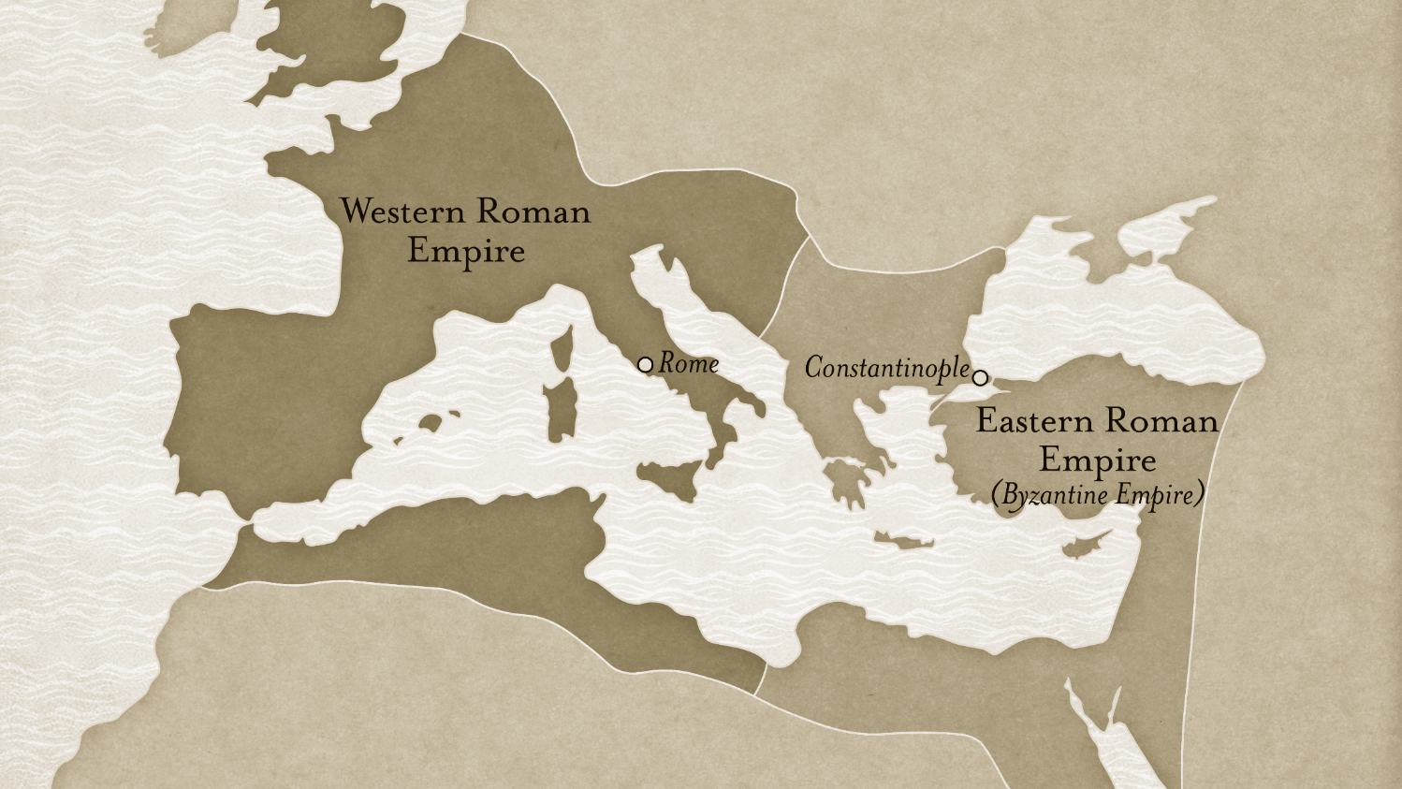

Slide 17
Fall of the Old

Slide 18
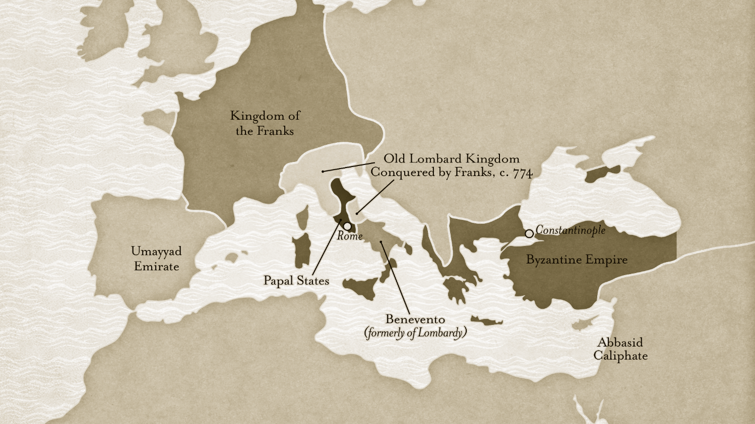

Slide 19
Rise of the New

Slide 20
Saving the Books

Slide 21
Proverbs 21:1
Discussion:

Slide 22
How do you think God has blessed His children through our current government?

Slide 23
Romans 13:1–7
Discussion:

Slide 24
Psalm 119:145–160
How would you describe the psalmist’s attitude toward God’s law?
  Confidence, hope, faith

Slide 25
Psalm 119:145–160
How do evil people react toward these same commands (vv. 150, 155)?
  They are far from the law/statutes.

Slide 26
Psalm 119:145–160
What does this psalm claim about God’s Word (vv. 152, 160)?
  They are true, and they will endure forever.

Slide 27
John 17:15–19
Context:

Slide 28
What do these passages teach us about God’s power?
Job 34:16–20
Psalm 2:1­–4
Acts 2:22­–24

Slide 29
King Alfred’s Handbook
Further Reading:

Slide 30
Alfred the Great
History

Slide 31
What did you think of Alfred’s “handbook”?

Slide 32
What do you think is the difference between learning the “flowers” of Scripture and studying the broad framework?

Slide 33
Why would Alfred want to translate Scripture from Latin into West Saxon?

Slide 34
Why do you think a Latin translation of the Bible was valuable during this time?

Slide 37
Christendom Divided
CHAPTER 9

Slide 38
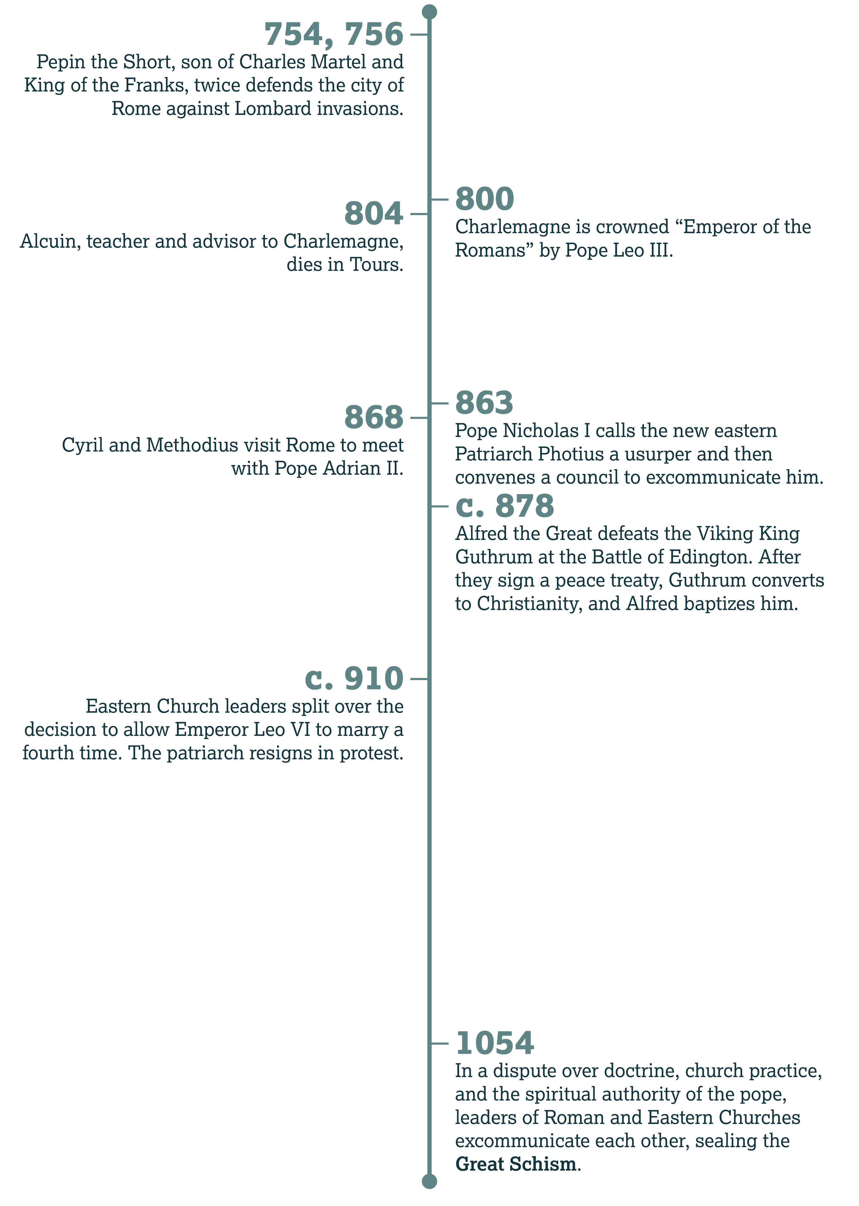

Slide 39
July 16, 1054
Introduction:

Slide 40
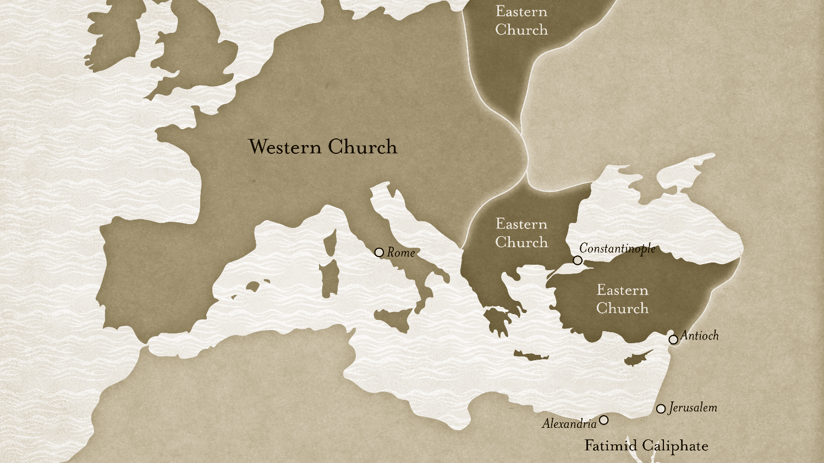

Slide 41
When Christians Disagree

Slide 42
Galatians 2
Why did Peter suddenly stop eating with the Gentiles (v. 12)?
  He feared those who promoted Jewish customs as a necessary part of Christianity.

Slide 43
Galatians 2
How did this decision in uence others (v. 13)?
  Other Jews and even Barnabas joined his hypocrisy.

Slide 44
Galatians 2
Read verse 14 and state in your own words why Peter’s actions were wrong.
  His behavior contradicted the gospel, which removes barriers between Jews and Gentiles. Why should Peter show preference to a group because of their ethnicity, especially when he ignored Jewish customs before?

Slide 45
Acts 10:9–16
Context:

Slide 46
Unity vs. Uniformity
Discussion:

Slide 47
When Christians Fight

Slide 48
Causes of Conflict
1 Corinthians 1:10–13
  B. Tribalism—Holding to a name or group blindly, without understanding doctrine

Slide 49
Causes of Conflict
Colossians 2:16–19
  A. Ritualism and Asceticism—Insisting that certain traditions are as important as Scripture; viewing suffering as a form of spiritual discipline

Slide 50
Causes of Conflict
Titus 3:9
  C. Combativeness—Arguing over absurd, insignificant points and theological mysteries

Slide 51
Causes of Conflict
James 4:1–10
  D. Pride and Greed—Allowing ambition and the desire for wealth to replace the worship of God

Slide 52
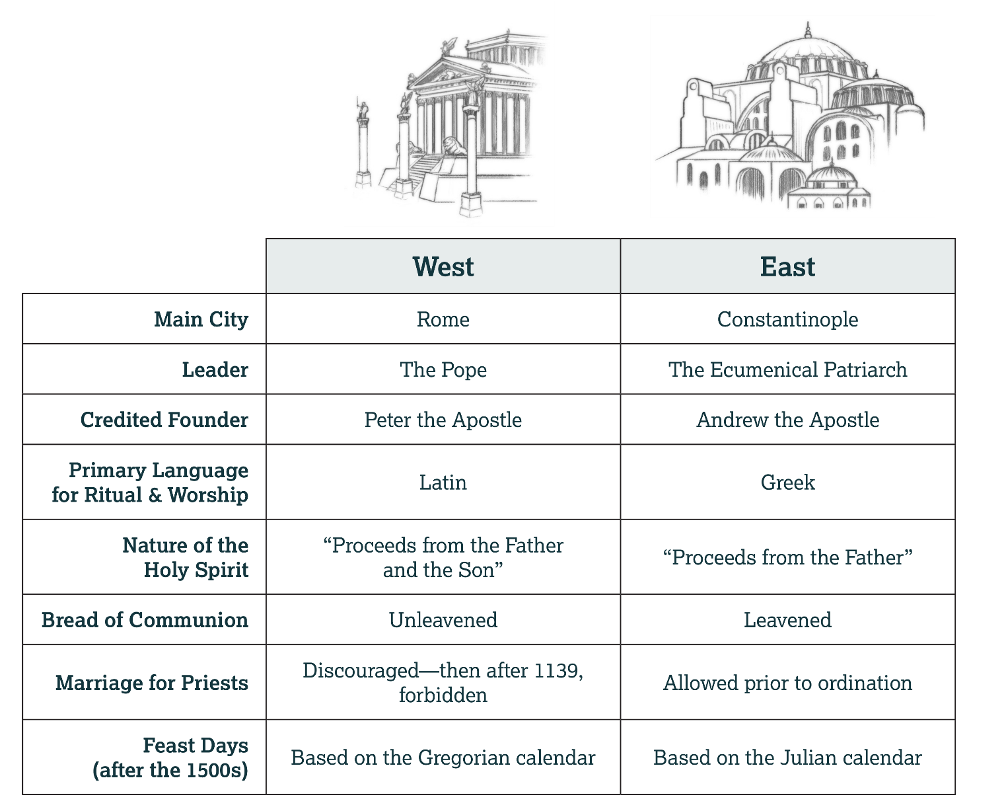

Slide 53
Filioque
History:

Slide 54
Gregorian and Julian Calendars
History:

Slide 55
The Fruits of Wisdom

Slide 56
James 3
What is the source of envy and selfish ambition (v. 15)?
  It is earthly and devilish. It does not come from above.

Slide 57
James 3
According to verse 16, what follows those attitudes?
  Disorder/confusion, every kind of vile/evil work

Slide 58
How does true, godly wisdom reveal itself in us? Note verses 13 and 17, and explain in your own words.

Slide 59
James 3
What results from this wisdom?
  Righteousness grown in peace

Slide 60
Ephesians 4
If we wish to pursue God’s calling for believers, what attitudes should we maintain (vv. 2–3)?
  Humility, meekness/gentleness, longsuffering/patience, love, and an eagerness to preserve unity.

Slide 61
Does Paul’s list of essentials seem too simple or short?

Slide 62
What things did you suggest that every Christian should believe?

Slide 63
What positions / practices could Christians disagree about—yet remain followers of Christ?

Slide 64
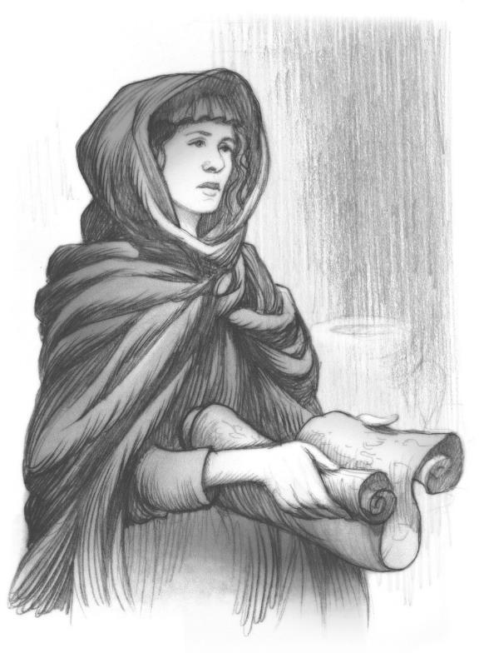
A Hymn of Kassia
Further Reading:

Slide 65
Penitential Hymn
History:

Slide 66
Note Luke 7:36–50 and
John 12:1–8.
Do you think Kassia captures the meaning of Scripture? Why or why not?

Slide 67
For what purpose would an assembly sing these lyrics during a service?

Slide 68
Why do you think it might be helpful for people to acknowledge their sin—or at least their sinful nature—during a service?

Slide 69
Note the imagery Kassia uses. Why would she compare tears and rain?

Slide 72
The Crusades
CHAPTER 10

Slide 73
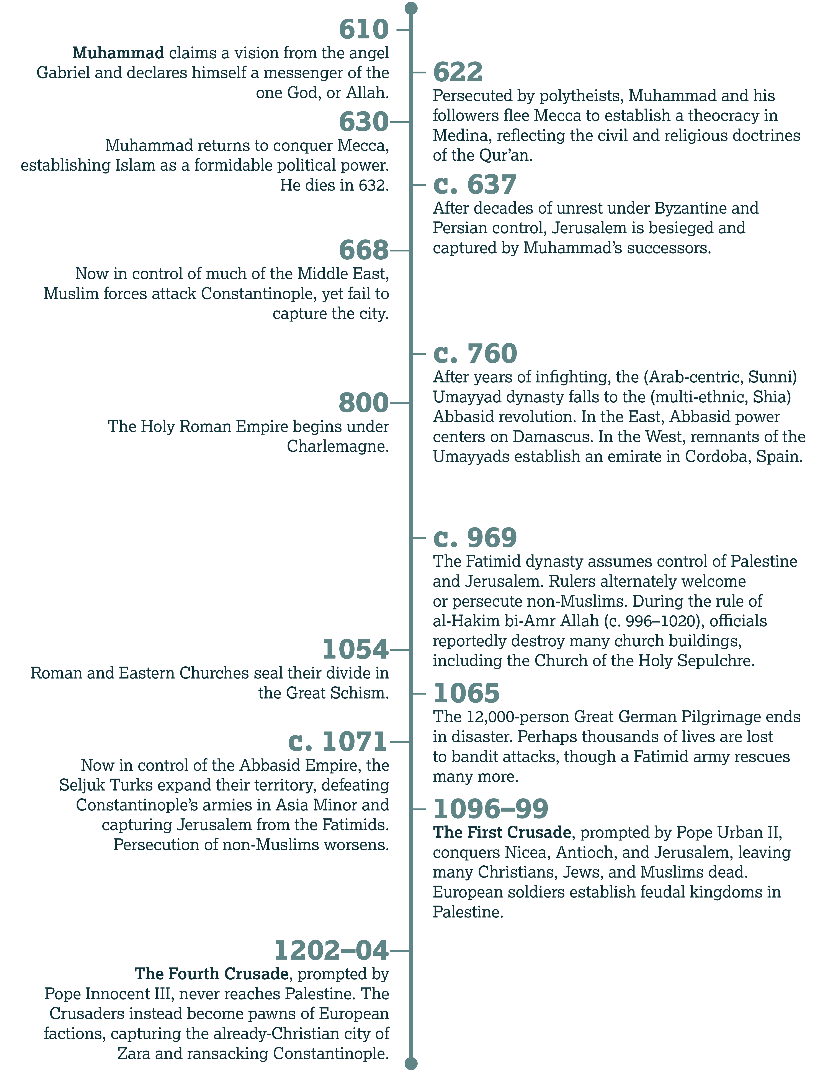

Slide 74
Urban II
Introduction:

Slide 75
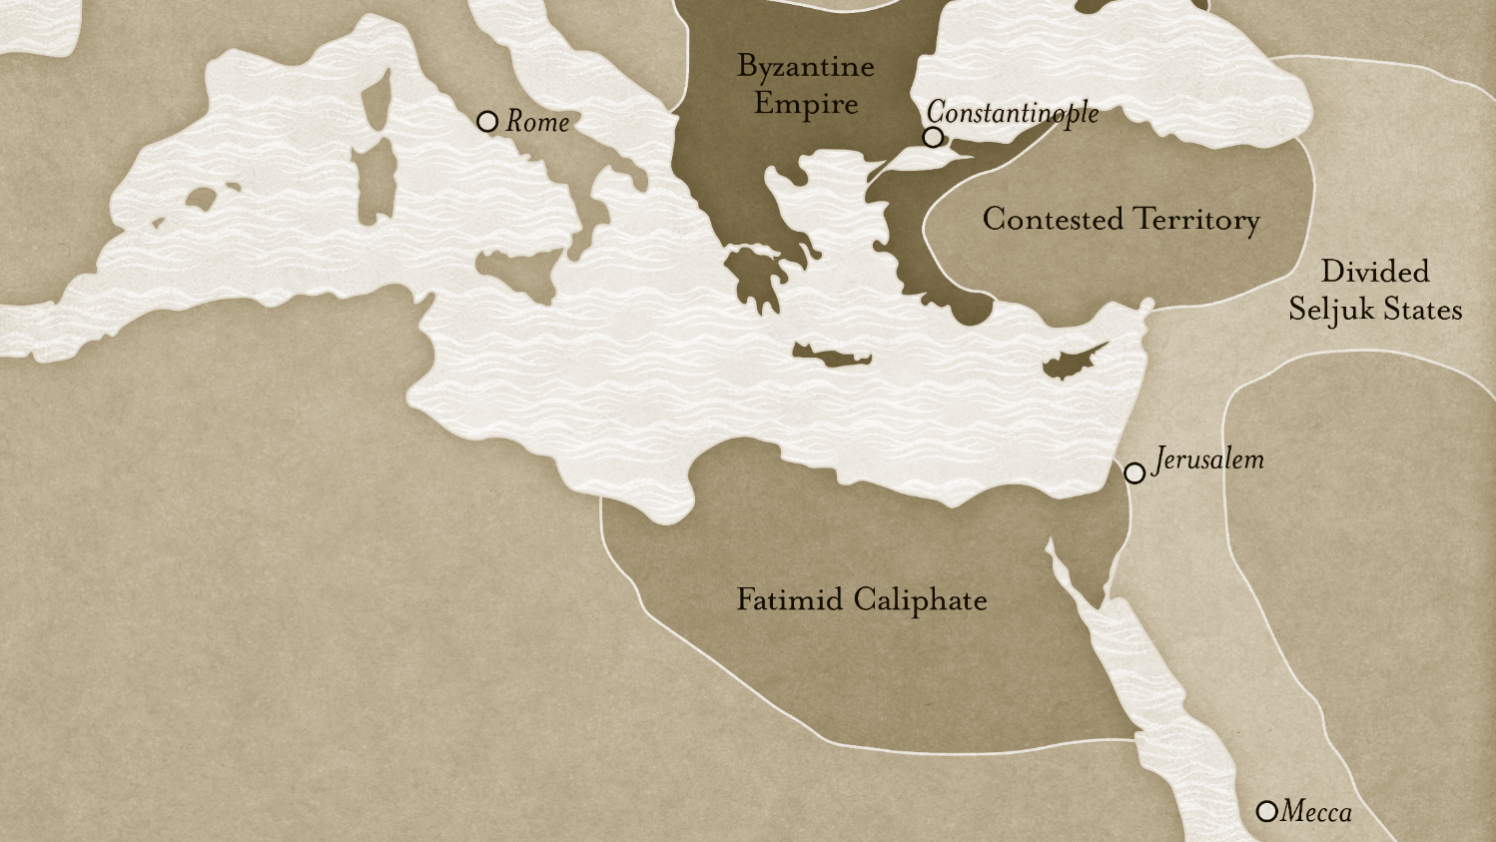

Slide 76
Defining a Crusade

Slide 77
Christians and Warfare

Slide 78
Can you think of passages in the New Testament that encourage peace?

Slide 79
Warfare in the
Old Testament
Context:

Slide 80
1 Peter 2
According to verse 14, what does God allow government officials to do?
  Punish those who do evil and praise those who do good.

Slide 81
How should believers generally respond when someone does them wrong?

Slide 82
Does this mean we allow ourselves to suffer harm for no good reason?
When should we prevent harm and pursue justice?

Slide 83
What do we gain by responding to mistreatment with kindness? What opportunities open to us?

Slide 84
Christian Soldiers
What did Jesus say about the centurion who sought His help (Matt. 8:10)?
  Jesus had not met anyone in Israel with greater faith.

Slide 85
Christian Soldiers
What did the conversion of the centurion Cornelius prove to the believers in Jerusalem
(Acts 10:45; 11:18)?
  That God saves and offers His Spirit to Gentiles as well as Jews

Slide 86
Why do you think Jewish Christians would be surprised that God would save a Roman centurion?

Slide 87
Luke 3
What instruction does John specifically give soldiers (v. 14)?
  Do not use your power to extort or mistreat people. Don’t accuse people falsely. Be content with your wages.

Slide 88
Luke 3
In warning soldiers against the abuse of power, does John command them to quit the military?
  No.

Slide 89
Augustine’s
Just War
Discussion:

Slide 90
From Europe to Jerusalem

Slide 91
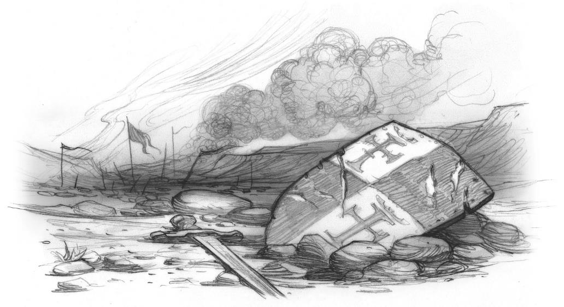
The Knights Templar

Slide 92
The Crusades Come to Europe

Slide 93
Matthew 26
Why did Jesus warn Peter to put away his sword (v. 52)?
  People who take up the sword will die by the sword.

Slide 94
General Truths
Context:

Slide 95
Christians and Deadly Force
Discussion:

Slide 96
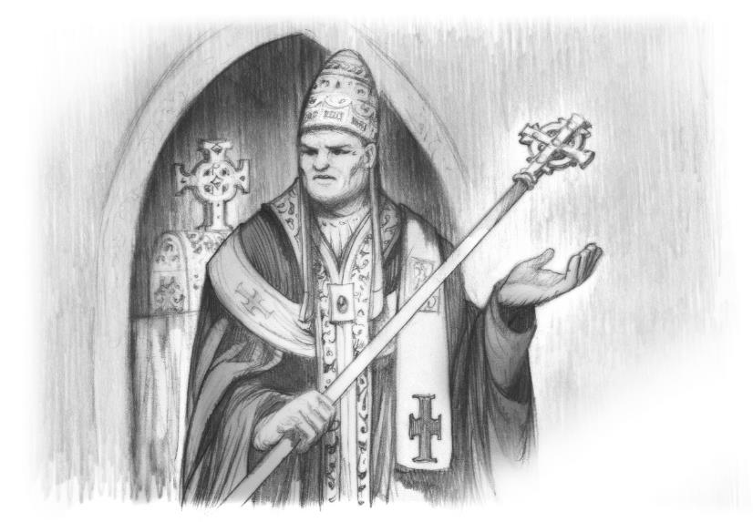
Innocent III and the Albigensian Crusade

Slide 97
The Third Crusade
History:

Slide 98
Ephesians 6
Where do we find strength
(v. 10)?
  In the Lord—in His power

Slide 99
Ephesians 6
Is the warfare of Christians primarily physical or spiritual
(v. 12)?
  Spiritual

Slide 100
Ephesians 6
Note the rest of this passage
(vv. 13–20). Name two pieces of equipment listed by Paul.
How do you think these tools help us handle conflicts?

Slide 101
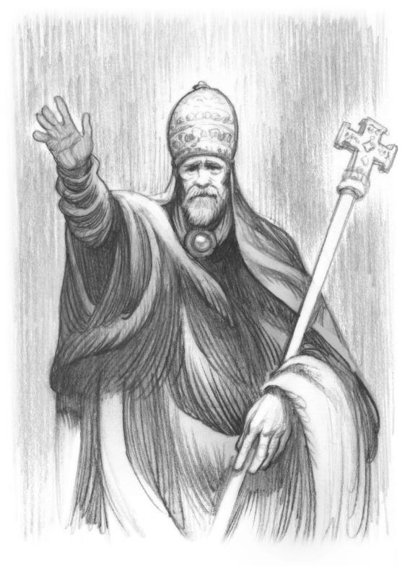
A Call for
Crusade
Further Reading:

Slide 102
Urban II’s Call
What does Urban II promise to those who die during the crusade?
  Immediate remission of sins

Slide 103
What does “remission of sins” mean?

Slide 104
How does that promise make the cross on a crusader shield ironic?

Slide 105
What are some phrases that make this a call to “holy” war?

Slide 106
The Dangers of Misdirected Faith
Context:

Slide 107
Do you see any phrases in this speech that could have encouraged crusaders to massacre unarmed people?

Slide 108
Urban II’s Call
In addition to the knights and nobles assembled at this council, whom does Urban call to join the crusade?
  Robbers, those fighting with family members, mercenaries, and manual laborers

Slide 109
Why do you think robbers, mercenaries, or peasants would find it attractive to join a crusade to the Middle East?

Slide 111
Out of the Cloister
CHAPTER 11

Slide 112
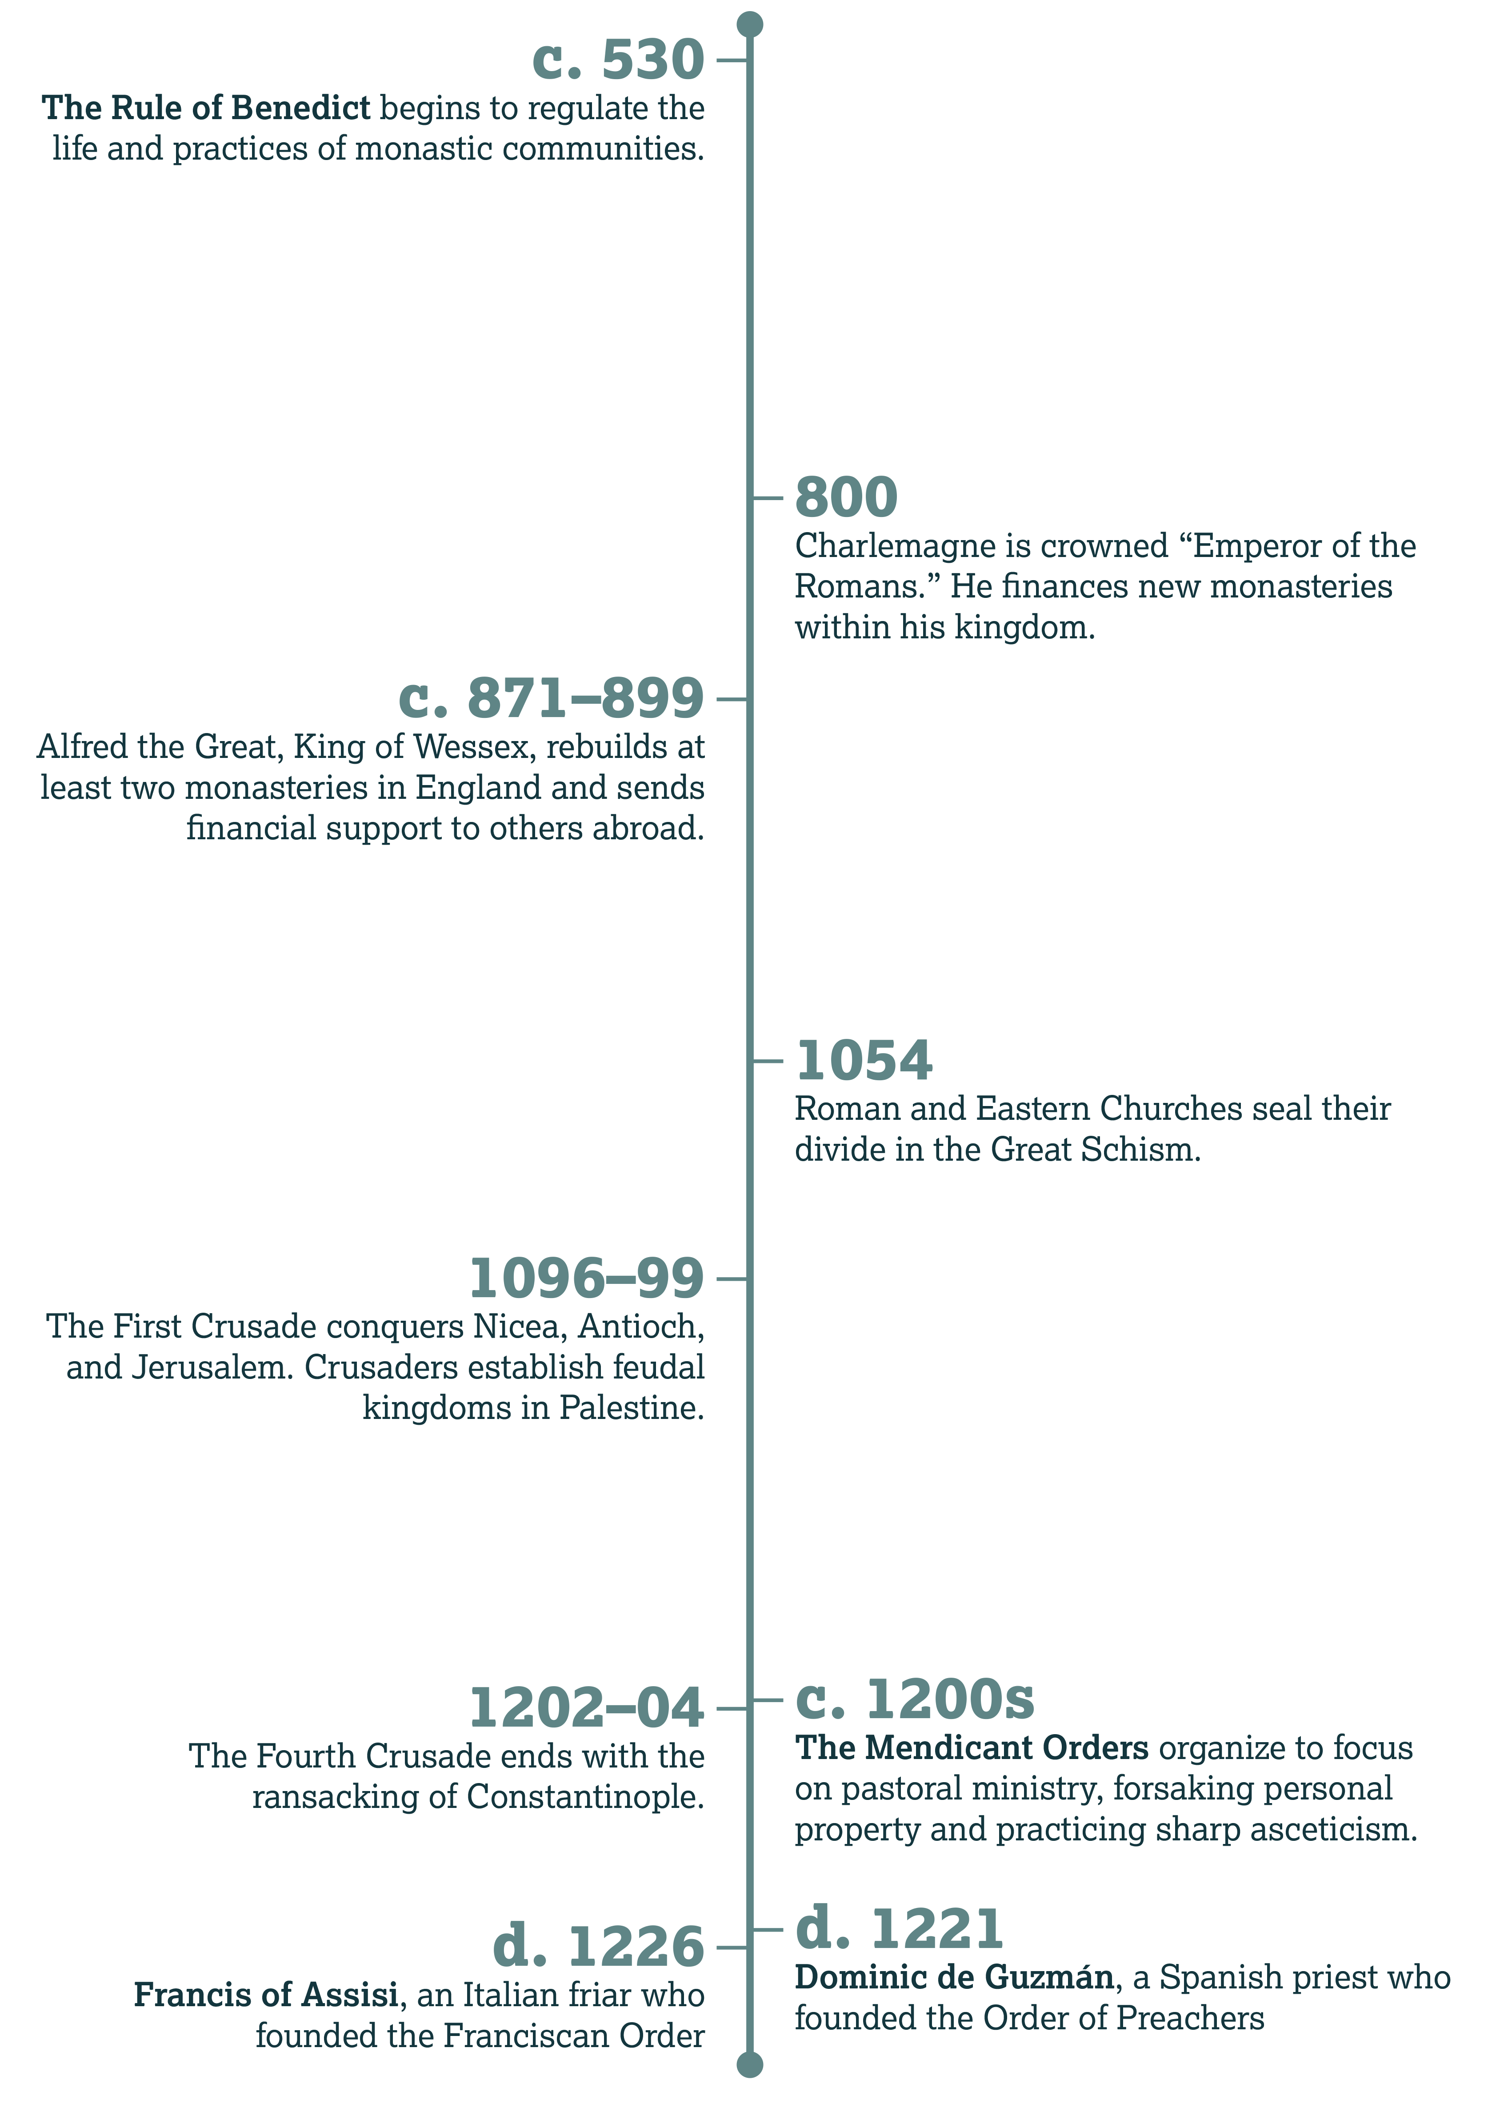

Slide 113
Dominic de Guzmán
Introduction:

Slide 114
Divisions Between the Church and the People:
Wealth

Slide 115
Wealthy Believers
According to Proverbs 14:31 and 17:5, what do we do when oppressing or mocking the poor?
  We insult/disrespect God.

Slide 116
Wealthy Believers
What teaching from Christ did the apostle relate (Acts 20:35)?
  It’s more blessed to give than to receive.

Slide 117
Wealthy Believers
Note also 1 Timothy 6:17–19. What attitude should we avoid (v. 17)?
  Pride or arrogance, trusting in uncertain riches

Slide 118
James 2:1–9
Context:

Slide 119
Divisions Between the Church and the People:
Education and
Privilege

Slide 120
Privilege and Christianity
In 1 Corinthians 1:26–29, Paul explains that God can use foolish and weak things to shame the wise and the strong. Why (v. 29)?
  So that no one could brag in God’s presence

Slide 121
1 Corinthians 8
According to verse 1, what is one result of knowledge?
  It puffs up—it can make us arrogant.

Slide 122
1 Corinthians 8
But what does love do (v. 1)?
  It builds up.

Slide 123
Privilege and Christianity
And according to 1 Corinthians 13:2, what do we gain from all gifts, knowledge, and faith—if we don’t have love?
  Nothing

Slide 124
Wealth, Power, and Evil
Discussion:

Slide 125
Rise of the Mendicant Orders

Slide 126
Benedict of Nursia
History:

Slide 127
Urbanization
History:

Slide 128
Legacy of the Mendicant Orders
History:

Slide 129
The Duty to
Reach Out

Slide 130
Matthew 25
What is the inheritance of those who serve God (v. 34)?
  His kingdom

Slide 131
Matthew 25
Why does the King reward believers who help people in need (v. 40)?
  To help those people is to serve God

Slide 132
What gifts have you seen people in this class use to help others? How have they encouraged you?

Slide 133
The Rule of Francis
Further Reading:

Slide 134
Did you notice the reference to Matthew 25:34–40 in these excerpts?

Slide 135
The Rule of Francis
What statements do you think guard against some of the corruptions of the Roman Catholic Church?
  The friars couldn’t own property or even accept money for work. They couldn’t debate with people, at least not harshly.

Slide 136
Do you think these restrictions went too far?

Slide 137
The Rule of Francis
What statements show that this order intended to minister to people directly?
  The rule included notes on traveling, working, and helping the sick.

Slide 138
What similarities do you notice between this rule and the ministry of Christ and the apostles?
Any big differences?

Slide 139
Do you think the advice given to preaching friars (Ch. 9) is helpful?
Why or why not?

Slide 140
Simple Messages
Discussion:

Slide 142
A Turbulent Darkness
CHAPTER 12

Slide 143
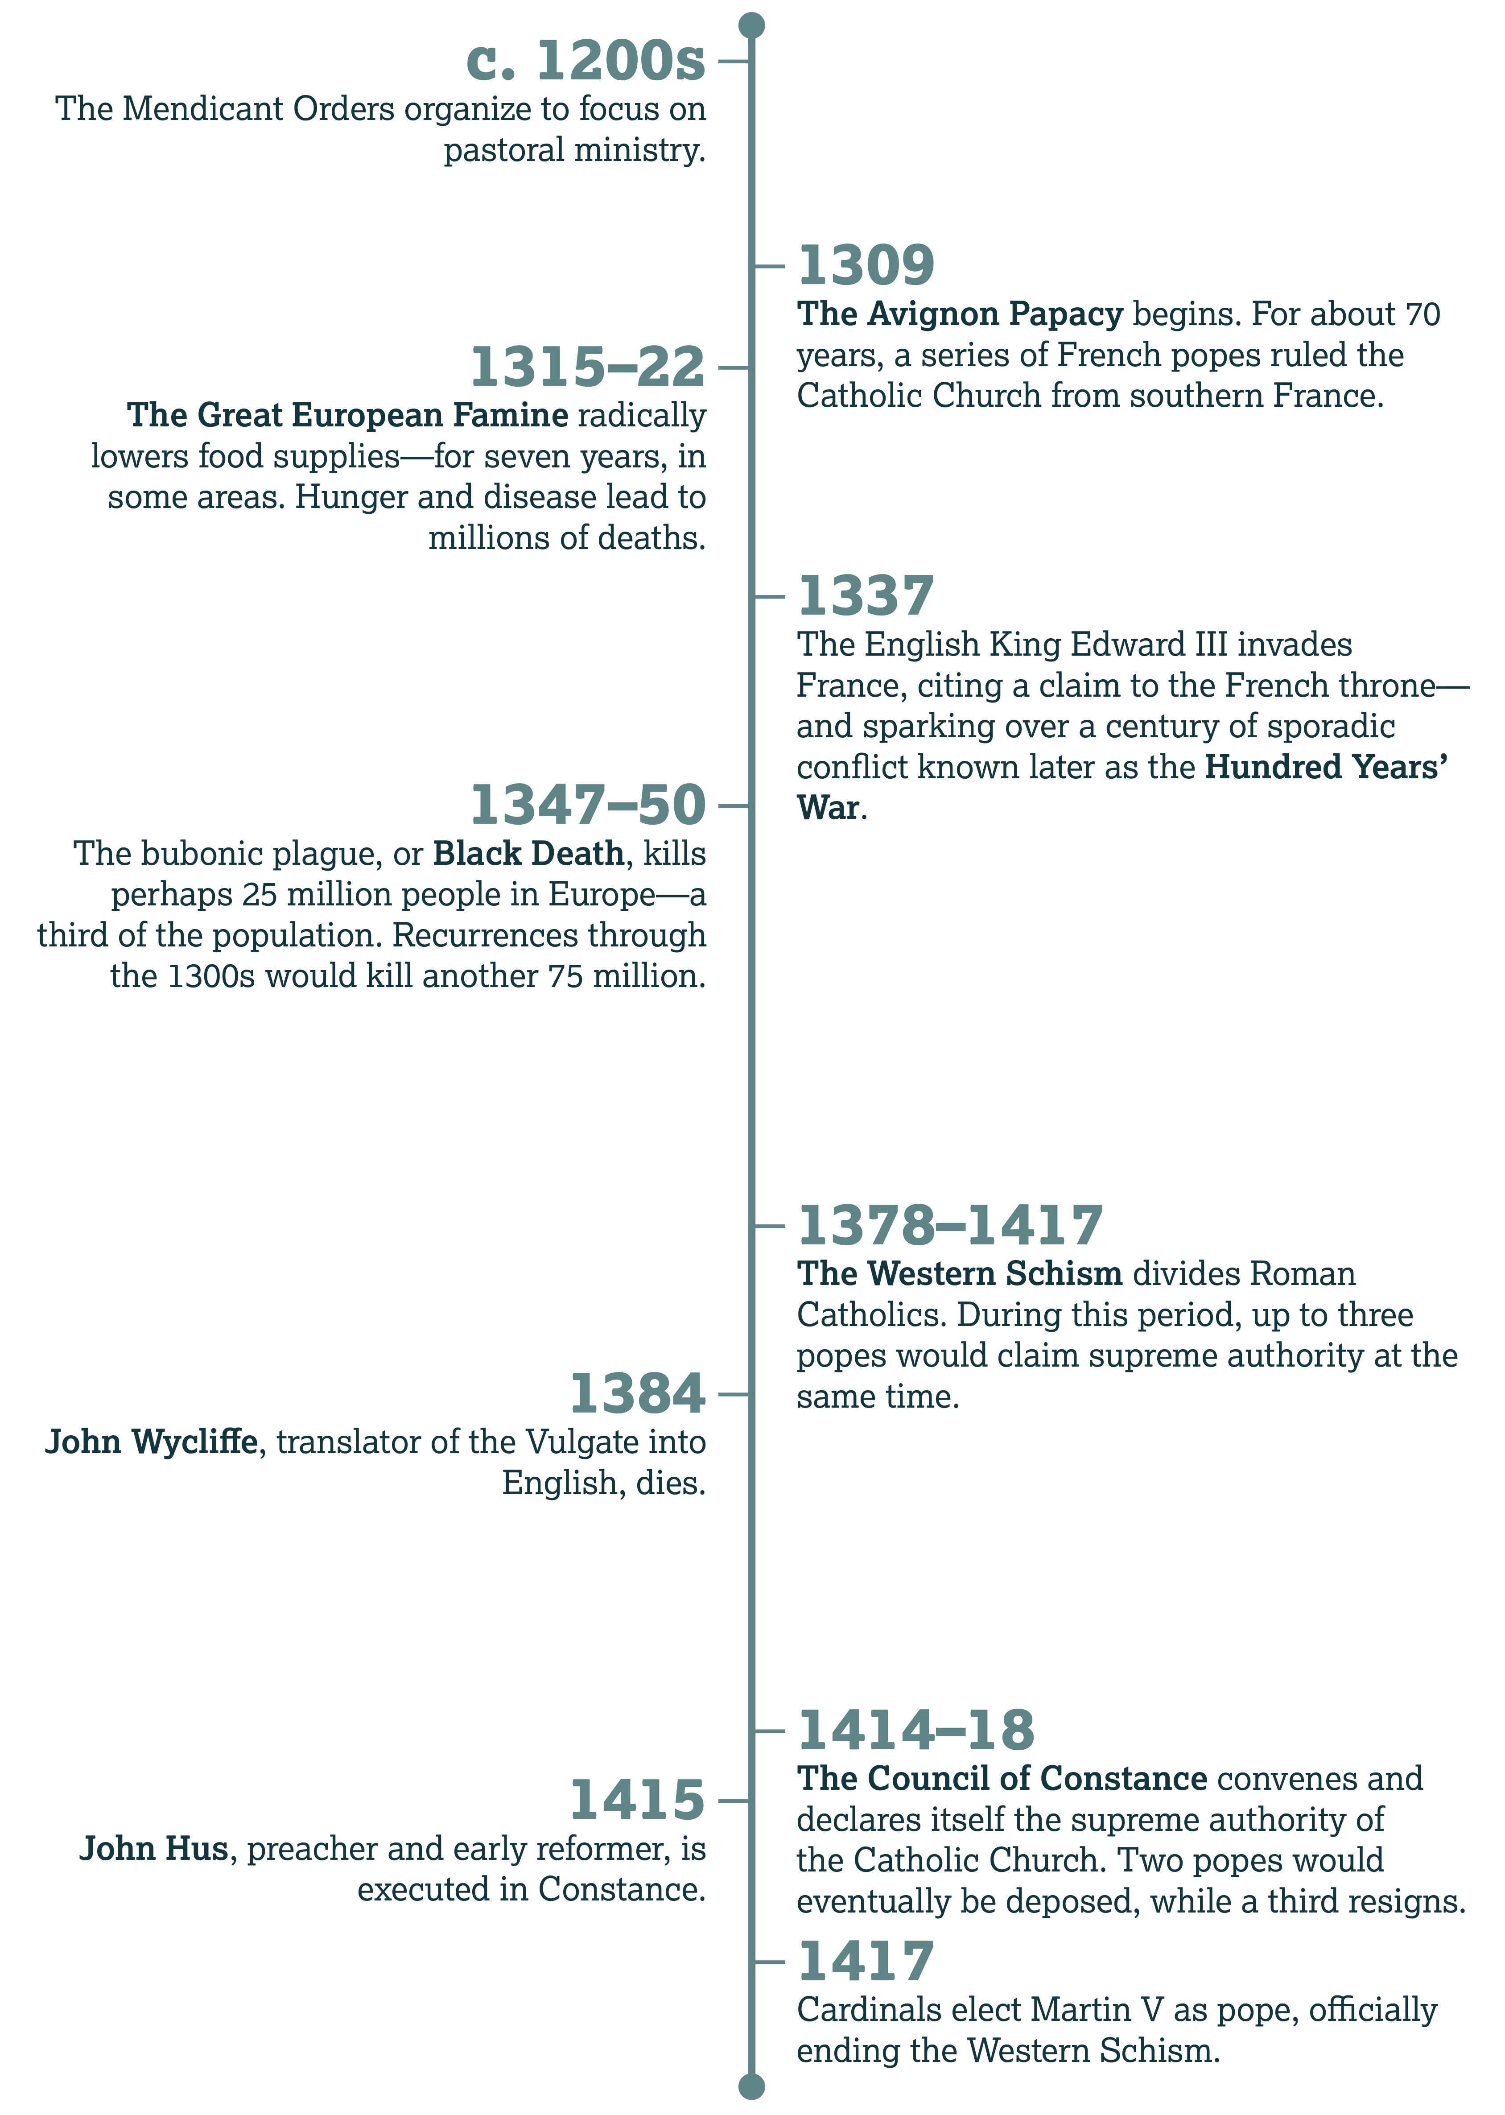

Slide 144
The Fourteenth Century
Introduction:

Slide 145
Dark Tales
History:

Slide 146
The Bubonic Plague
History:

Slide 147
Quarantine
History:

Slide 148
Joan of Arc
History:

Slide 149
Signs of the End
Discussion:

Slide 150
Where Was the Church?

Slide 151
The Avignon Papacy

Slide 152
The Babylonian Captivity
History:

Slide 153
Petrarca’s Letter
What seems to be Petrarca’s biggest criticism of the curia in Avignon?
  Likely hypocrisy and love of wealth

Slide 154
If you lived in England during the Hundred Years’ War, what would you think of the Avignon Papacy?

Slide 155
Given the famine, plagues, and wars of the 1300s, how do you think common people viewed the opulence of the Avignon papacy?

Slide 156
What advice would you offer believers discouraged by religious hypocrisy?

Slide 157
Matthew 23
According to verses 5–7, what did the Pharisees want from these rituals and titles?
  They wanted to be seen by others (v. 5). They wanted attention and honor.

Slide 158
Matthew 23
In obsessing over insignificant rules, what did these leaders ignore (v. 23)?
  Justice, mercy, and faith/faithfulness

Slide 159
Matthew 23
And by focusing on their appearance, what did they allow to grow inside (vv. 27–28)?
  Death, uncleanness, hypocrisy, and wickedness/lawlessness

Slide 160
Matthew 23
What then did Jesus tell His followers to do (vs. 2–3)?
  Do what the Pharisees say to do—but don’t imitate their actions.

Slide 161
Do you think church leaders face a greater temptation for hypocrisy?
Why or why not?

Slide 162
The Western Schism

Slide 163
Catherine of Siena
History:

Slide 164
Political Popes
History:

Slide 165
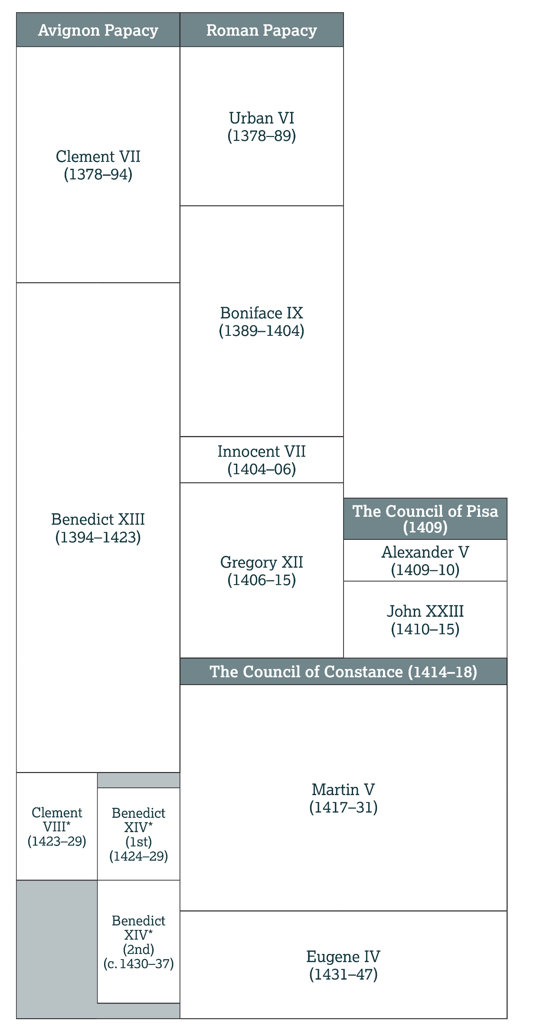

Slide 166
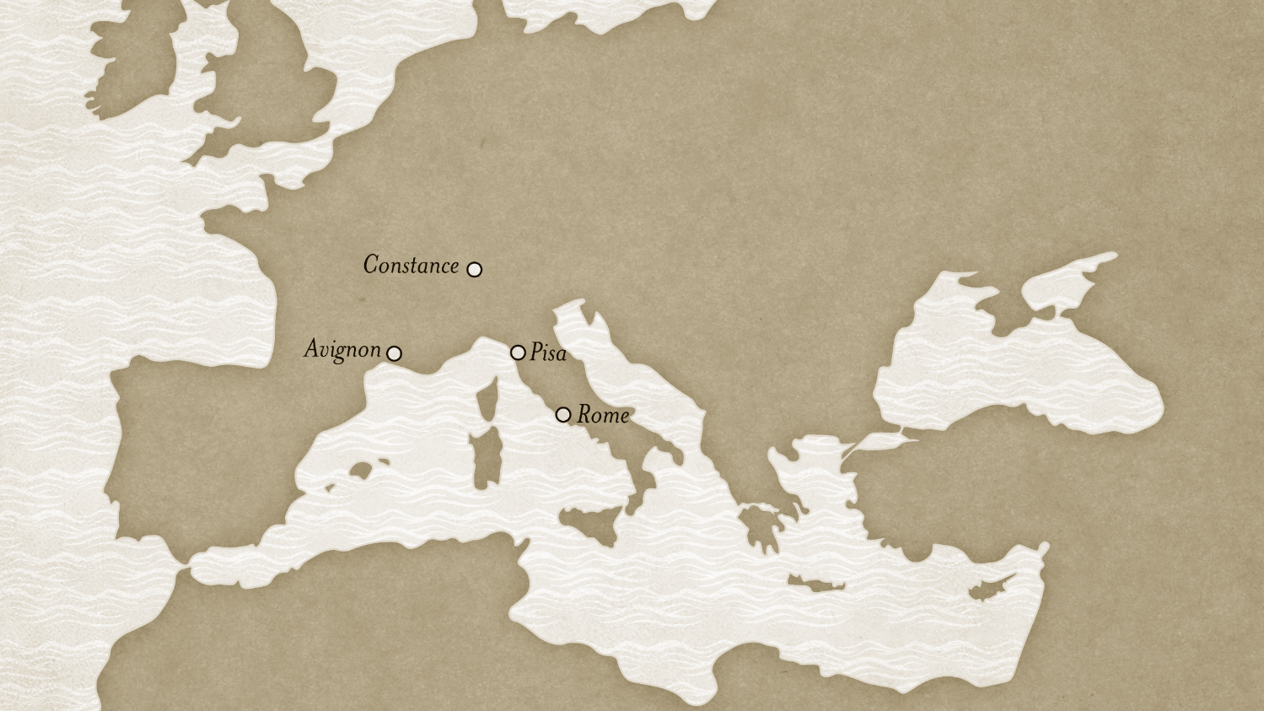

Slide 167
How did the bad attitudes of James 4 reveal themselves in the Church disputes of the 1300s?

Slide 168
Conflicts Today
Discussion:

Slide 169
Henry Knighton on Wycliffe
Discussion:

Slide 170
Sparks of the Reformation

Slide 171
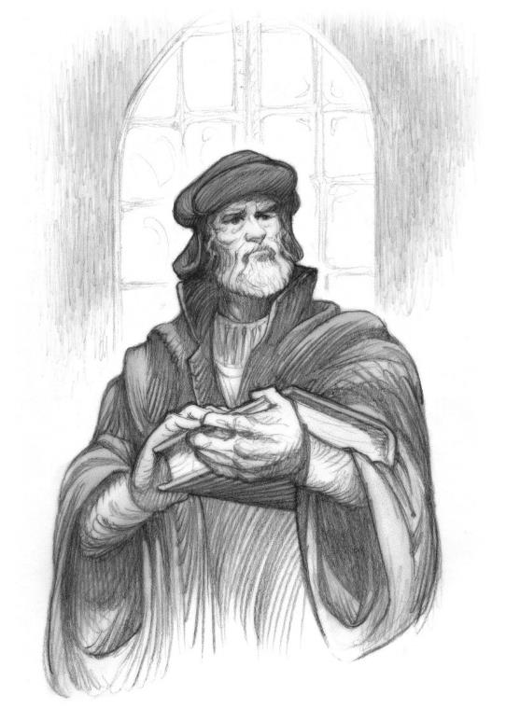
John Wycliffe

Slide 172
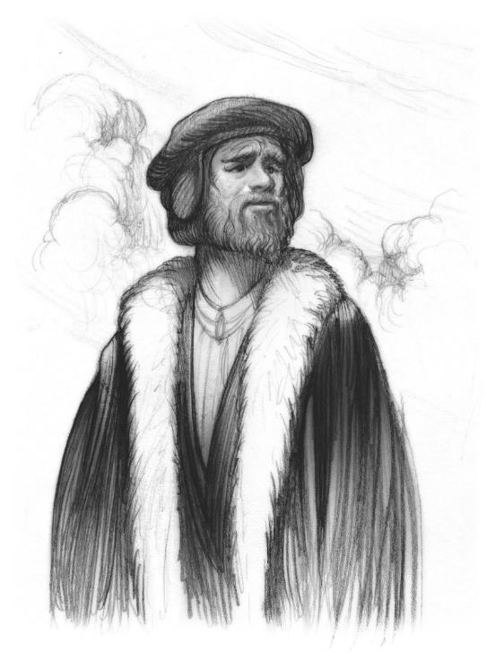
John Hus

Slide 173
Indulgences
History:

Slide 174
Why do you think the teachings of Wycliffe and Hus were so offensive to the Catholic Church?

Slide 175
A Final Goodbye
Further Reading:

Slide 176
How did you summarize Hus’s thoughts?

Slide 177
Why do you think John Hus asked for prayer, even if he assumed he would die anyway?

Slide 178
What do you think Hus meant by his last plea—to “preserve in the truth of God”?

Slide 180
The Light of the Word
CHAPTER 13

Slide 181
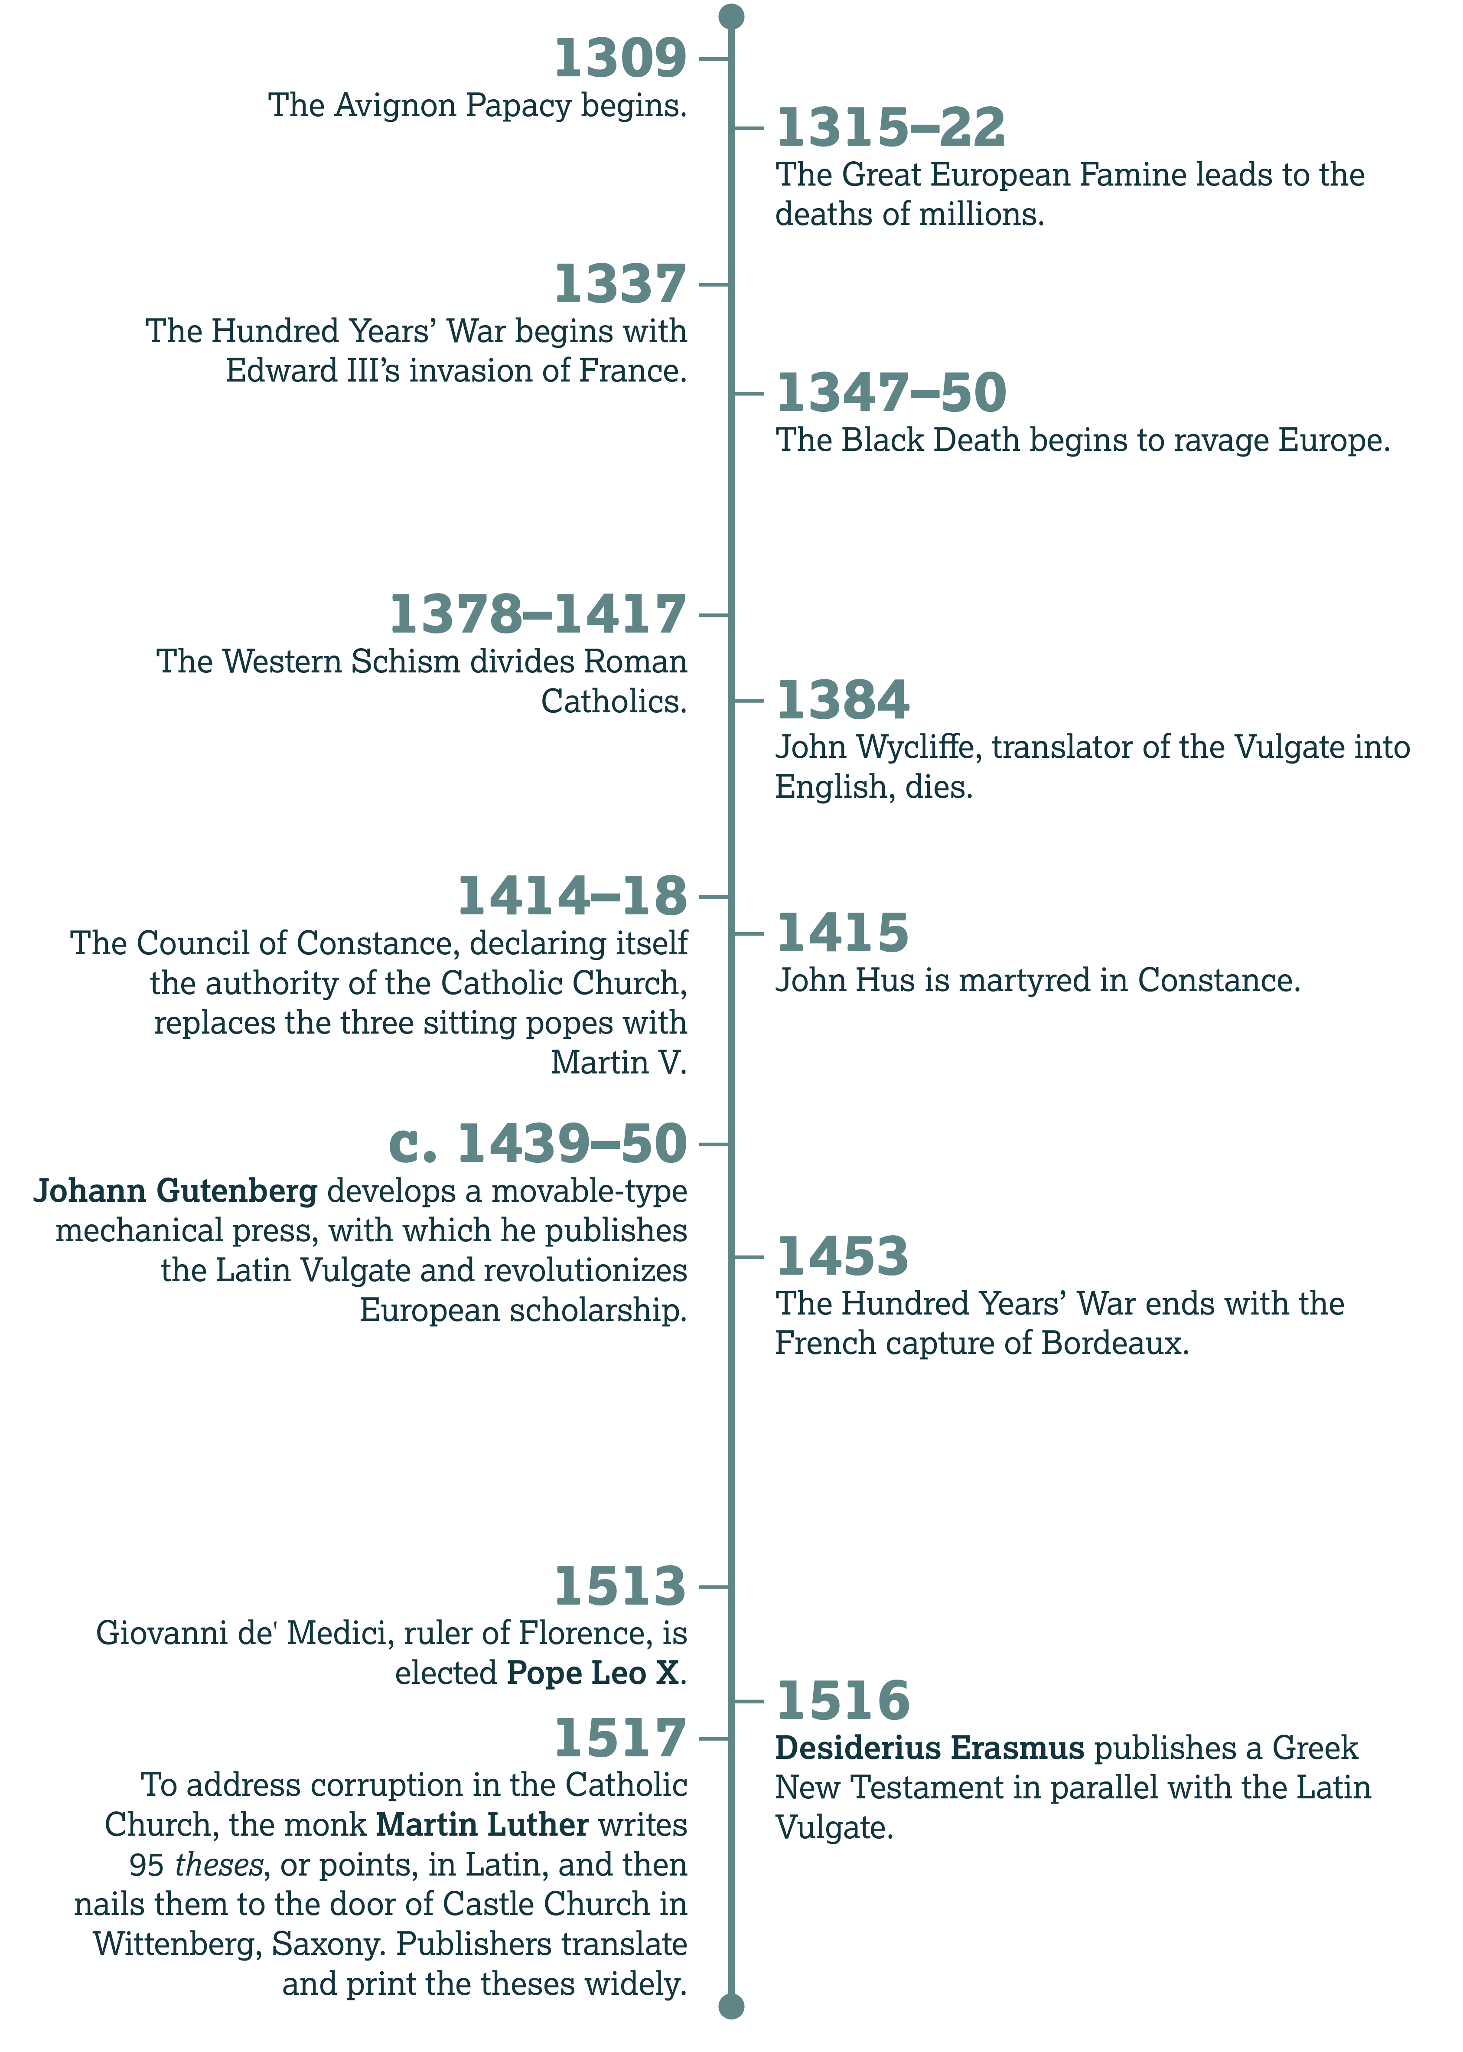

Slide 182
Martin V
Introduction:

Slide 183
The Hussite Wars
History:

Slide 184
Following the Light

Slide 185
1 John 1
In verses 1–2, John says that he and the other apostles have seen, heard, and even touched the “Word of Life.” Who do you think he means by this?
  The apostle refers to Jesus Christ.

Slide 186
John 1:1–5
Context:

Slide 187
1 John 1
And because they’ve met this Word, what do the apostles do now (vv. 3–4)?
  Teach and write about what they’ve learned, so that others can know the Father and His Son

Slide 188
Luke 11
According to verse 28, who are blessed?
  Those who hear the word of God and keep/obey it

Slide 189
Luke 11
But what do many people look for instead (v. 29)?
  A sign

Slide 190
Luke 11
What imagery does Jesus then use to describe the truth of God’s Word (v. 33)?
  A lamp/light

Slide 191
Luke 11
What happens if we do not focus on this light (vv. 34–35)?
  We will be filled with darkness.

Slide 192
Obstacles to Study
Discussion:

Slide 193
Darkness
Before Dawn

Slide 194
Julius II
History:

Slide 195
Julius Excluded from Heaven
History:

Slide 196
Religious Corruption
Discussion:

Slide 197
The Word Rises

Slide 198
Outsourcing
Our Beliefs
Discussion

Slide 199
Promise of the Word
Matthew 5:17–18
  Nothing in the Law will pass away—everything will be accomplished.

Slide 200
Promise of the Word
1 Peter 1:22–25 (cf. Isaiah 40:6–8)
  The Word of the Lord remains/abides forever.

Slide 201
Christ and the Law
Context:

Slide 202
Looking for
His Hand
Discussion:

Slide 203
Heralds of the Light

Slide 204
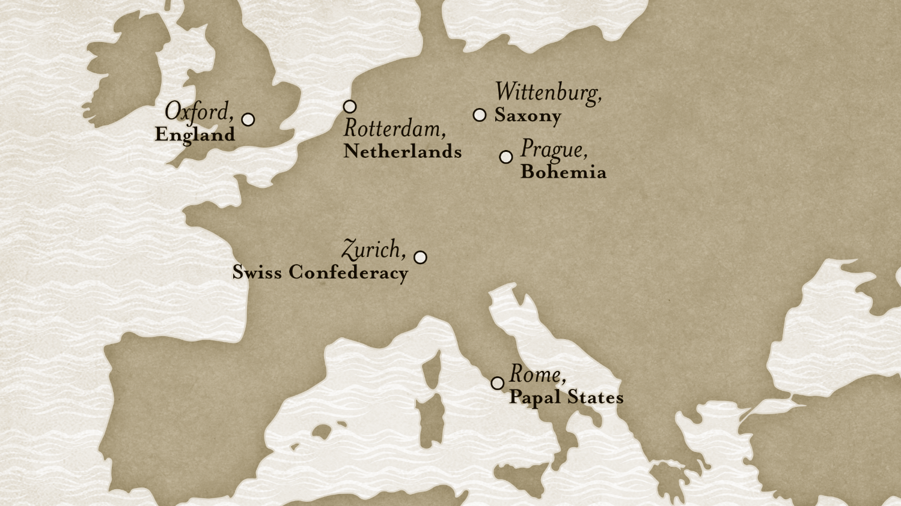

Slide 205
Erasmus’s Sources
History:

Slide 206
Trent on the Vulgate
History:

Slide 207
Romans 1:17
History:

Slide 208
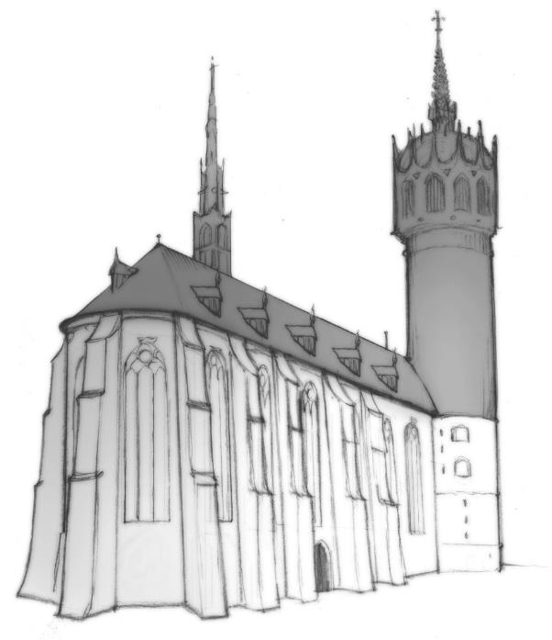
Luther’s Arguments
History:

Slide 209
Hebrews 4
In verse 12, what imagery does the writer use to picture the Word of God?
  It’s living, active—sharper than a double-edged sword.

Slide 210
Hebrews 4
What can the Word do (v. 12)?
  Reveal the divisions of soul and spirit; interact with our thoughts and intentions

Slide 211
Hebrews 4
Can anyone hide from this power (v. 13)?
  No.

Slide 212
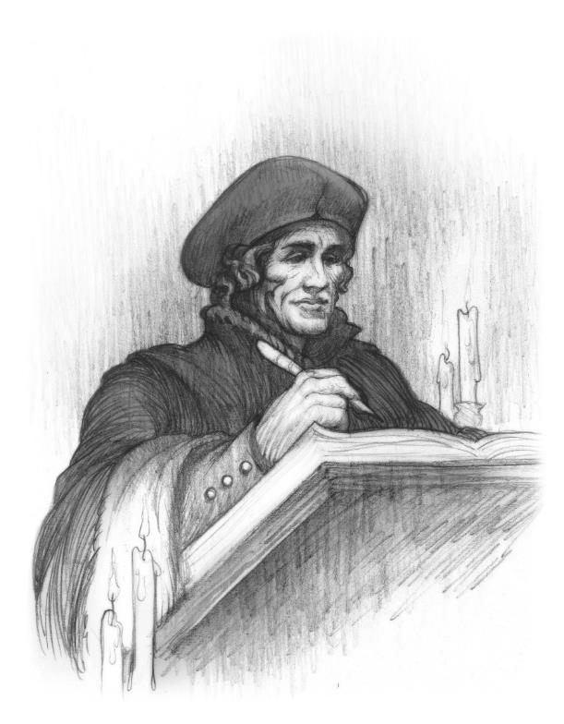
Christ in the Word
Further Reading:

Slide 213
Did you agree with Erasmus’s take on the preconditions for the gospel?

Slide 214
Based on your knowledge of the culture in Erasmus’s day, what statements do you think people found surprising?

Slide 215
Erasmus seemed to want the words of Scripture to be as common to people as folk songs and traveler’s tales.
Why do you think that some would find that idea disrespectful?

Slide 216
What did you think of Erasmus’s last point—the one comparing statues of Christ to His depiction in the Word?

Slide 217
Psalm 78:1–4
Final Note:

