Slide 2
Be All That You Can Be
LESSON 1

Slide 3
Understanding Sin
Sin is . . .
  Anything that violates the character of God.
  All that is contrary to what God is, the way God thinks, and what God wants.

Slide 4
Understanding Holiness
What is God’s most basic attribute?
  Holiness

Slide 5
The Importance of Holiness
Holiness is the only attribute of God to which an entire book in the Bible is devoted.

Slide 6
The Importance of Holiness
Purpose of Leviticus
  To teach God’s people to be holy before the Lord.
  God tells Israel 16 times to be holy because He is holy

Slide 7
The Importance of Holiness
Holiness is the only attribute for which the heavenly creatures praise Him in triplicate
(Is. 6:3; Rev. 4:8).
Holiness is the one attribute of God that speaks most directly to His deity.

Slide 8
The Meaning of Holiness
OT Hebrew word—qodesh
NT Greek word—hagios
Holiness is: separation (or being set apart) for a particular purpose

Slide 9
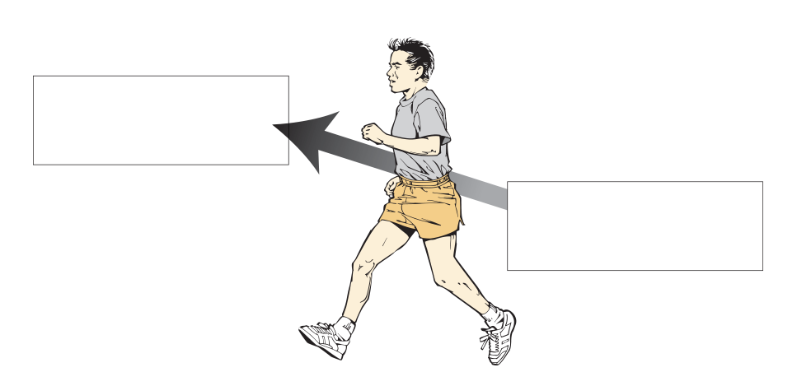
Two Aspects of Separation (1 Thess. 1:9)
To God
From evil

Slide 10
The “Tenses” of Holiness
Time | Type | Applied to Believers | How We Get It | When We Get It | Duration
Past | Positional | What we are | By grace through faith | The instant we are saved | Eternal
Present | Practical/progressive | What we are becoming | By groaning and growing | From salvation to death | Momentary

Slide 11
The “Tenses” of Holiness
Time | Type | Applied to Believers | How We Get It | When We Get It | Duration
Future | Perfected/prospective | What we will be | By going to heaven | At death | Forever

Slide 12
Positional Sanctification
We are sons of God (1 John 3:1)
We are the temple of God
(1 Cor. 6:19–20)
We are saints of God (1 Cor. 1:2)

Slide 13
Practical/Progressive Sanctification
We are perfect, but don’t act perfectly (Heb. 10:14).
We are the Spirit’s temple and should glorify God in our actions (1 Cor. 6:19–20).

Slide 14
What Does This Mean?
We are to grow continually
(2 Pet. 3:18).
We are to increase and abound
(1 Thess. 3:12; 4:1, 10).
We need pastors and teachers (Eph. 4:11–15).

Slide 15
What Does This Mean?
The Christian life is a constant struggle to be all that we can be and to become all that we already are (Phil.3:12–14).

Slide 16
Perfected/Prospective Sanctification
We should strive to be all that we can be.

Slide 18
Destined For Holiness
LESSON 2

Slide 19
God Is Holy
Exodus 15:11—God is glorious in holiness.
Psalm 99:3—His name is holy.
Isaiah 1:4—He is the Holy One of Israel.

Slide 20
God Is Holy
Hosea 11:9—His holiness proves He is God.
Psalm 89:35—God swears by His holiness.

Slide 21
Two Important Truths About God’s Holiness
He is above all things
(Ps. 99:2–9).
He is morally perfect.
  He cannot look upon sin (Hab. 1:13).

Slide 22
Two Important Truths About God’s Holiness
  He cannot lie (Titus 1:2).
  Only the pure can come before Him (Ps. 24:3–4).
  He is righteous in all His ways and holy in all His works (Ps. 145:17).

Slide 23
God Designed Us to Be Holy
We have a life endowment for holiness
(Matt. 25:14–30; Luke 19:12–27).
Believers are chosen by God to be holy (Eph. 1:4).
Believers are created to do good works (Eph. 2:10).

Slide 24
God Designed Us to Be Holy
All that Christ has done and is doing is designed to make us holy (Eph. 5:25–27).
God has given us all the resources we need to be holy
(2 Pet. 1:3).

Slide 25
God Designed Us to Be Holy
God commands us to be holy
(1 Pet. 1:14–16)
Living a holy life is God’s will
(1 Thess. 4:3).
Living a holy life means growth and change.

Slide 26
Ways God Commands Us To Grow
In all things (Eph. 4:15)
In love (1 Thess. 3:12)

Slide 27
Ways God Commands Us To Grow
In your knowledge of the Word
(1 Pet. 2:2)
In grace and knowledge of the Lord Jesus Christ (2 Pet. 3:18)

Slide 29
Separation from Sin
LESSON 3

Slide 30
Two Sides to Sanctification
Separation to God
Separation from evil.

Slide 31
Separation from Sin
Separation from all sin is commanded by God.

Slide 32
The Commands
Consider yourselves dead to sin.
Do not let sin reign.
Do not yield yourself to be used as a tool of unrighteousness.
Yield yourself to God.

Slide 33
The Commands
Do not let sins be named among you.
Put to death the part of you that desires to sin.
Put off personal sins.
Do not lie to others.

Slide 34
Separation from Specific Sins
2 Corinthians 7:1—Defilement of the flesh and spirit
Ephesians 5:3–4—Sexual immorality, impurity, covetousness, filthiness, foolish talking, jesting

Slide 35
Separation from Specific Sins
Colossians 3:5–7—Sexual immorality, impurity, sinful passions, evil desire, covetousness
Colossians 3:8–9—Anger, wrath, malice, slander, filthy communication, lying

Slide 36
Sins on God’s
“Most Wanted” List
Defilement of the flesh and spirit (2 Cor. 7:1)
  Filthiness of the flesh refers to sins of attitude.
  Filthiness of the spirit refers to sins of atmosphere.

Slide 37
Sins on God’s
“Most Wanted” List
Sexual immorality—A lack of self-control
Impurity—Indecent gestures and language
Filthiness—Disgraceful talk

Slide 38
Sins on God’s
“Most Wanted” List
Jesting—Immoral jokes
Sinful passions (Col. 3:5) and evil desire—Sexual passion and mental lusting
Slander (or blasphemy)—Defaming others

Slide 39
Separation from Sin
Can Be Both External and Internal
Of the previous list of sins, how many are internal in nature?
  6

Slide 40
Separation From Sin Requires Effort.
It requires correct thinking (Rom. 6:11).
It requires yielding
(Rom. 6:12–13).
It requires putting to death
(Col. 3:5).

Slide 41
Separation From Sin Requires Effort.
It requires putting off and putting on (Col. 3:8, 10).
It requires cleansing and confessing
(2 Cor. 7:1; 1 John 1:9).

Slide 42
Separation From Sin Is Possible for a Christian.
God has given us all the resources we need for victory
(1 Cor. 10:13).
  The Word of God (Ps. 119:9, 11)
  The Holy Spirit
  (Rom. 8:13; Gal. 5:16, 22; Eph. 3:16)
  Prayer (Eph. 6:18)

Slide 43
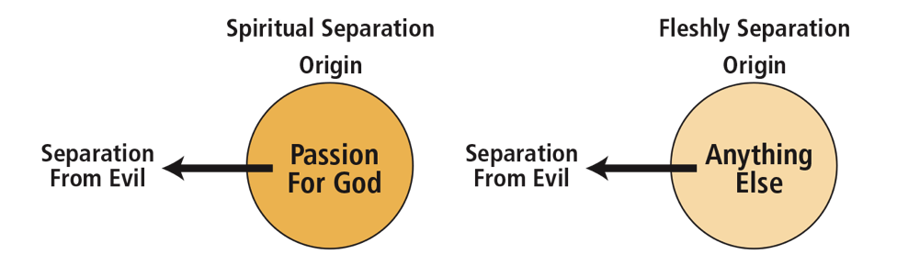

Slide 45
Separation from the Ungodly
LESSON 4

Slide 46
How to Respond to Disobedient Christians
We should pray for them
(1 John 5:16).
We should counsel them
(Matt. 18:15; Gal. 6:1).

Slide 47
How to Respond to Disobedient Christians
Four Steps
  Confronting them with their sin
  Showing them what God’s Word says about their sin
  Offering to help them overcome their sin
  Praying with them about their sin

Slide 48
How to Respond to Disobedient Christians
We must seek to restore them (Gal. 6:1; 2 Thess. 3:14–15).
Counsel intended for restoration, not revenge.

Slide 49
Restoration | To perfect or make complete
Admonish | To warn or exhort

Slide 50
How to Respond to Disobedient Christians
We may have to break associations with them
(2 Thess. 3:6, 14).
We must accept them when they repent (2 Cor. 2:5–11).

Slide 51
How to Respond to False Teachers
Mark them (Rom. 16:17).
Avoid them (Rom. 16:17c; Titus 3:9–11; 2 John 7–11).
  The divisive teacher (Rom. 16:17)
  The deceptive teacher (2 John 7–11)

Slide 52
How to Respond to False Teachers
Warn others against them
(Acts 20:28–31).

Slide 54
Separation from the World
LESSON 5

Slide 55
Defining Purity
Synonym for holiness: purity
The word “pure” means single.

Slide 56
What Is Worldliness?
Worldliness is living for this world.
It is getting so caught up in pleasures and treasures of the here and now that we neglect the Lord.

Slide 57
What Is Worldliness?
Worldliness is really an attitude that results in an action.
Worldliness = double-mindedness

Slide 58
What Does God Say
About Worldliness?
Worldliness replaces love for the Lord (1 John 2:15).
Worldliness chokes the Word and destroys fruit (Matt. 13:22).

Slide 59
What Does God Say
About Worldliness?
Worldliness binds (Gal. 4:3).
Worldliness disregards the future (1 John 2:17).

Slide 60
What Does God Say
About Worldliness?
Worldliness is spiritual immorality (James 4:4).
Worldliness pollutes a Christian (James 1:27; 2 Pet. 2:20–22).

Slide 61
How Do We Prevent Worldliness?
By guarding our focus
(Prov. 4:23–27)
By making wise use of our time (Eph. 5:15–16)
By filling our minds with God (Rom. 12:1–2)

Slide 63
Separation to the Lord
LESSON 6

Slide 64
Why We Should
Thirst for God
He is all-sufficient. He is the source of all . . .
  Joy (Hab. 3:18).
  Peace (Is. 26:3).
  Godly wisdom (Eccl. 2:26; James 1:5).

Slide 65
Why We Should
Thirst for God
  Answered prayer (John 15:16; 16:23).
  Spiritual fruit (Gal. 5:22).
  Spiritual power and strength
  (John 15:5).
  Eternal life (John 3:15–16).

Slide 66
Why We Should
Thirst for God
He is all-surpassing. He exceeds all in . . .
  Majesty (1 Chron. 29:11; Ps. 104:1)
  Brilliance
  (Ps. 104:2; 1 Tim. 6:16; Rev. 1:13–16)

Slide 67
Why We Should
Thirst for God
  Wisdom (Rom. 11:33; 1 Cor. 1:25)
  Lovingkindness (or faithful love)
  (Ps. 36:7; Jer. 32:18)

Slide 68
How We Show Our
Thirst for God
We show our passion for God by surrendering . . .
  Our bodies—to serve Him (Rom. 12:1)
  Our minds—to know Him (Phil. 3:10)
  Our hearts—to love Him (Ps. 18:1)

Slide 69
How We Show Our
Thirst for God
  Our wills—to obey Him (Deut. 32:46)
  Our souls—to worship Him
  (1 Chron. 16:29; Ps. 29:2)
  Our possessions—to work for Him (Acts 2:45)
  Our lives—to glorify Him (Eph. 1:12)

Slide 70
A Heart Check-Up (Ps. 42)
Do you desire to know God more than anything else?
Do you want to be where God is?
Do you get upset when God is mocked?

Slide 71
A Heart Check-Up (Ps. 42)
Do you enthusiastically live for God?
Does your faith outlast difficult times?

Slide 72
A Heart Check-Up (Ps. 42)
Do you have recent memories of time spent with God?
How do you view bad events in life?

Slide 74
Separation To the Praise & Glory of the Lord
LESSON 7

Slide 75
Christ Excels All . . . | How Christ Excels All
In His pre-existence. | He lived before He was born.
In His birth. | He was virgin born.
In His life. | He never sinned.
In His speech. | His speech was perfect.

Slide 76
Christ Excels All . . . | How Christ Excels All
In His death. | He dismissed His life from His body. His death was effectual.
In His resurrection. | He rose again by His own power.
In His present work. | He is answering our prayers, preparing a place for us, and defending us from Satan.
In His Second Coming. | He is coming back.

Slide 77
Why God Made Us
God made man for one reason—to glorify Him (Is. 43:7).

Slide 78
Why God Saved Us
God saved man to glorify Him once more
(Eph. 1:5–7, 12, and 14).

Slide 79
Our Righteous Response
Set apart our bodies—to serve Him (Rom. 12:1)
Set apart our minds—to know Him (Phil. 3:10)
Set apart our hearts—to love Him (Ps. 18:1)

Slide 80
Our Righteous Response
Set apart our wills—to obey Him (Deut. 32:46)
Set apart our souls—to worship Him (1 Chron. 16:29; Ps. 29:2)

Slide 81
Our Righteous Response
Set apart our possessions—to work for Him (Acts 2:45)
Set apart our lives—to glorify Him (Eph. 1:12)

Slide 82
Jesus, the Christ | History’s Great Leaders
His tomb: empty! | Their tombs: full of bones
His kingdom: universal, eternal | Their kingdoms: small, decaying

Slide 84
Separation to the Worship & Service of the Lord
LESSON 8

Slide 85
Two Kinds of Separation
 | Carnal Separation | Biblical Separation
Motives | Pride, peer pressure, selfishness | A passion for God
Attitudes | Self-righteous, mean-spiritedness, harshness | Gentleness, brokenness, firmness
Purpose |  | 1 Thessalonians 1:9

Slide 86
Understanding Service (Rom. 12:1–2)
Godly service is motivated by the mercies of God.

Slide 87
Six Motivational Mercies of Romans 1–11
Romans 4–5 | Justification (“made innocent”)
Romans 6–8 | Freedom from the penalty and power of sin
Romans 8:1–2; 31–39 | Assurance of salvation

Slide 88
Six Motivational Mercies of Romans 1–11
Romans 8:17 | An inheritance with Christ
Romans 8:26 | The Spirit to help us
Romans 9–11 | The Gentiles were given an opportunity to be saved.

Slide 89
Understanding Service (Rom. 12:1–2)
Godly service is a form of worship.

Slide 90
Understanding Worship
What Worship Is | How We Worship the Lord
Worship is recognizing “worth-ship.” | We recognize Christ is worthy of our worship.
Worship is expressing “worth-ship.” | We express the “worth-ship” of Christ. To the Lord To others Publicly and privately

Slide 91
Understanding Worship
What Worship Is | How We Worship the Lord
Worship is serving the one worshipped. | We serve Him because He is worthy.
Worship is guarding or protecting the reputation of the one worshiped. | We guard and protect His name and reputation.

Slide 92
Understanding Worship
What Worship Is | How We Worship the Lord
We worship Him in all we do. | 1 Corinthians 10:31

Slide 93
Final Analysis
True holiness or separation is motivated by a fierce passion for God that results in sacrificial service to Him.

