Slide 1
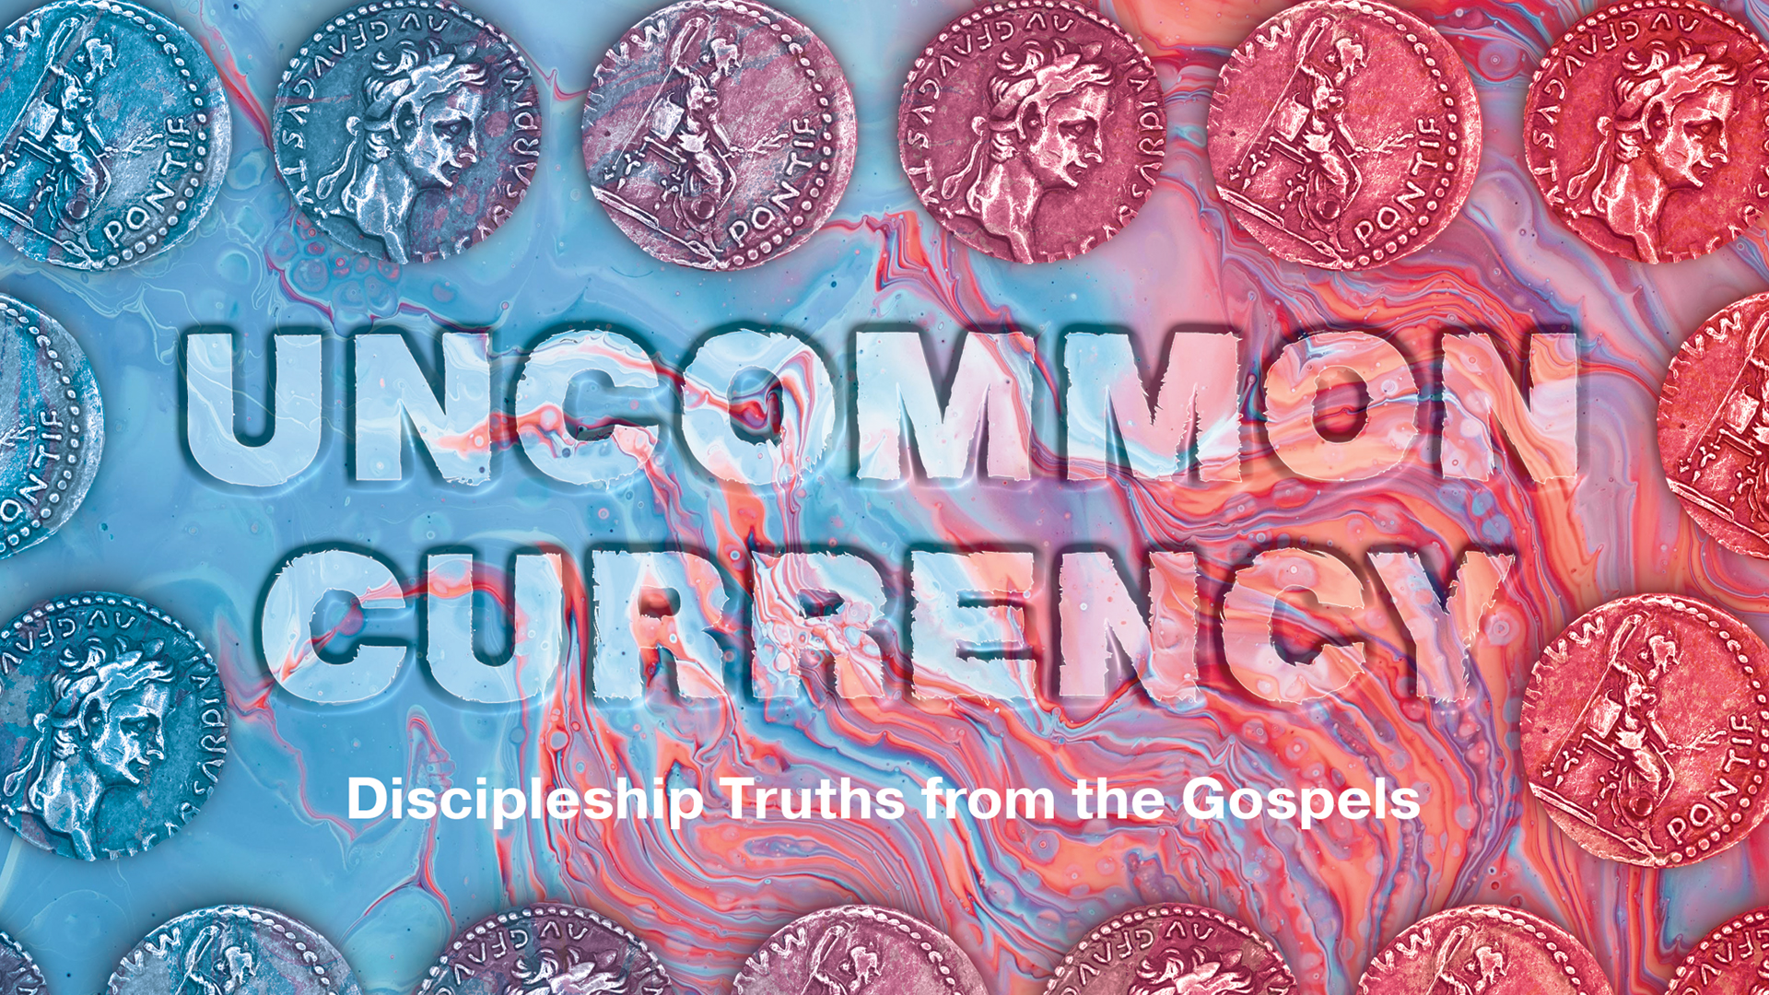

Slide 2

The Denarius: Grace and Gratitude
LESSON 1

Slide 3
What does it mean to follow Jesus?

Slide 4
God Graciously Seeks Disciples (vv. 1–7)
The Kingdom of Heaven and Vineyard Workers
The Denarius Was a Generous Reward for the Workers
The Master Continues to Hire Workers

Slide 5
God Generously Promises Disciples (vv. 8–12)
The Last-Hired Workers Are Generously Rewarded First
All Workers Are Generously Rewarded Equally
Disciples Are Rewarded in Eternity

Slide 6
God Sovereignly Rewards His Disciples (vv. 13–16)
The Master Decides How to Reward His Workers
All Workers Will Be Rewarded Equally

Slide 7
If eternal rewards are equal, does it matter what you do with your life?

Slide 8
God Sovereignly Rewards His Disciples (vv. 13–16)
The Master Decides How to Reward His Workers
All Workers Will Be Rewarded Equally

Slide 10

The Stater: Honor and Humility
LESSON 2

Slide 11
Can you name different ways people use money?

Slide 12
Will Jesus Pay the Temple Tax (v. 24)?
The Tax Collector’s Question for Peter
Why Wouldn’t Jesus Pay the Tax?

Slide 13
Because Jesus Is the Son of the King, He Doesn’t Have to Pay (vv. 25–26)?
Jesus’ Question for Peter

Slide 14
What question does Jesus ask? Why do you think He asks this?

Slide 15
Because Jesus Is the Son of the King, He Doesn’t Have to Pay (vv. 25–26)?
Jesus’ Question for Peter
The Meaning of “Son of God”
Christians Are Sons of God

Slide 16
Because Jesus Is Humble, He Chooses to Pay (v. 27)
The Stater
Humble Disciples Are Not Concerned with Their Own Greatness (Matt. 18:1–4)
Humble Disciples Consider Other Disciples (Matt. 18:5–6)
Humble Disciples Forgive Wrongs Done to Them (Matt. 18:21–35)

Slide 18
The Lepton: Devotion and Dependence
LESSON 3

Slide 19
Not All Disciples Are Genuine (v. 41)

Slide 20
Anyone Can Become a Genuine Disciple (v. 42)

Slide 21
Is it possible for Christians to act like they are devoted to God but actually just serve themselves?

Slide 22
Anyone Can Become a Genuine Disciple (v. 42)
The Lepton
Anyone Can Become a Disciple

Slide 23
Genuine Disciples Are Devoted to God (vv. 43–44)

Slide 24
What could have motivated the poor widow to make this sacrifice?

Slide 26
The Drachma: Repentance and Rejoicing
LESSON 4

Slide 27
We Search for Lost Valuables (v. 8)
The Drachma
The Woman’s Desperate Search

Slide 28
Can you think of another example from Scripture when someone searched for something that was lost?

Slide 29
We Rejoice When We Find What Was Lost (v. 9)

Slide 30
The Lord Rejoices When Lost Sinners Are Found (v. 10)
Repentance
Humility and Discipleship

Slide 32
The Assarion: Fortitude and Fear
LESSON 5

Slide 33
The fear of God is loving reverence towards God expressed through humble obedience.

Slide 34
Friend of Jesus Need Not Fear Other People (v. 4)
Friendship and Fellowship
Friendship and Allegiance
Friends of Jesus Can Be Fearless

Slide 35
Friend of Jesus Fear God
(v. 5)

Slide 36
Friends of Jesus Should Not Fear Hell

Slide 37
Friend of Jesus Are Cared for by God (vv. 6–7)
The Assarion
Jesus Values His Disciples

